Slide 1
Bone Fracture Detection
Prepared By
B. Lal Pramodh
K. Deekshitha

Slide 2
What is a Bone Fracture?
A bone fracture is a medical condition where there is a partial or complete break in the continuity of a bone. It usually results from trauma, overuse, or diseases like osteoporosis or bone cancer that weaken the bones.
Types of Bone Fractures:
Closed (Simple) Fracture – Bone breaks but does not pierce the skin.
Open (Compound) Fracture – Bone breaks and pierces through the skin.
Transverse Fracture – Break is in a straight line across the bone.
Oblique Fracture – Break has a curved or sloped pattern.
Spiral Fracture – Fracture spirals around the bone, often caused by twisting force.
Comminuted Fracture – Bone shatters into three or more pieces.
Greenstick Fracture – Bone bends and cracks, instead of breaking completely (common in children).
Stress Fracture – Small cracks in the bone due to repetitive force or overuse.
Impacted Fracture – Bone fragments are driven into each other.

Slide 3
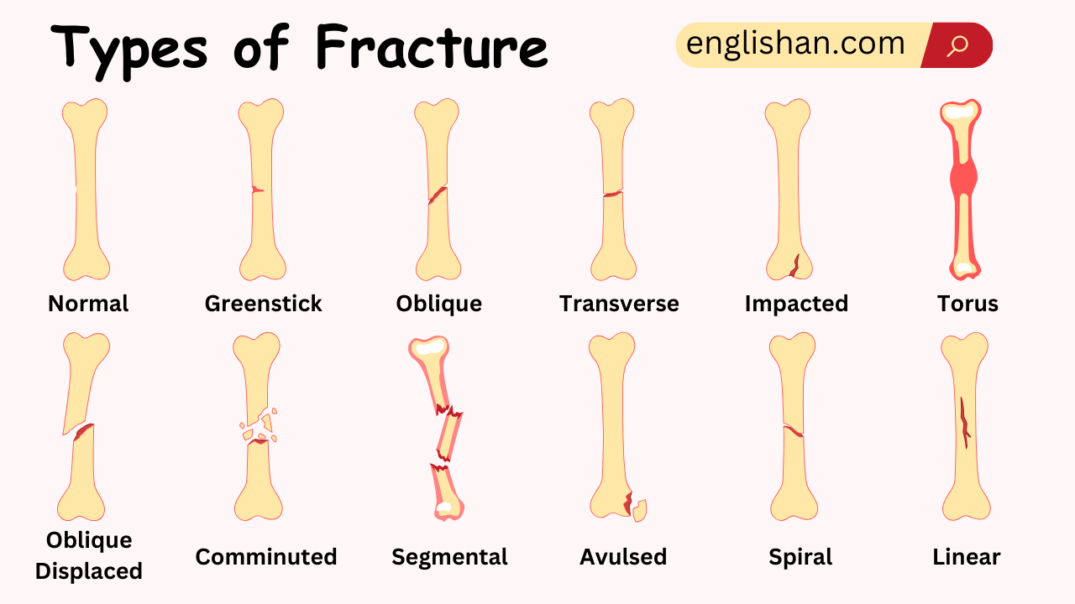

Slide 4
Where Do Fractures Commonly Occur?
Fractures can happen in any bone, but commonly affected areas include:
Wrists
Forearms
Elbows
Shoulders
Hips
Legs and Ankles

Slide 5
Main Purpose of the Project: Bone Fracture Detection Using Deep Learning and Machine Learning
Objectives:
Early and accurate detection of fractures using image analysis.
Reduce misdiagnosis and human error in reading X-rays.
Speed up clinical decision-making for doctors and radiologists.
Assist in fracture classification (e.g., fractured vs. non-fractured, type of fracture, severity).
How It Works:
Deep Learning (e.g., CNNs, EfficientNet, ViT): Used to automatically extract features from X-ray images and classify fracture presence or type.
Machine Learning models: Used for training and predicting based on patterns in medical imaging.
Hybrid Models (e.g., YOLO + EfficientNet): Used for both fracture localization (object detection) and classification.

Slide 6
Why This Is Important:
Reduces reliance on highly skilled radiologists in low-resource settings.
Supports telemedicine and remote diagnostics.
Increases efficiency and scalability in hospitals.
Enhances diagnostic confidence and decision support.

Slide 7
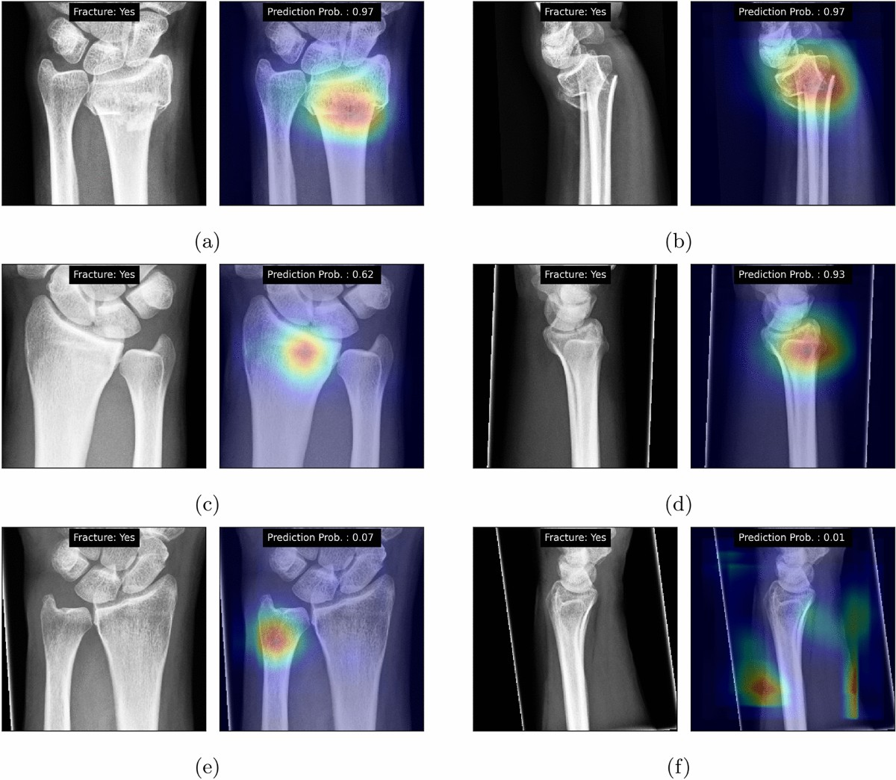
Existing Models

Slide 8
Existing Models
CNN Models
VGG16
ResNet50
InceptionV3
DenseNet121
EfficientNet (B0–B7)
Transfer Learning Models
ResNet (Pretrained)
DenseNet
Inception
EfficientNet
MobileNetV2
Object Detection Models
YOLOv5
YOLOv7
YOLOv8
Faster R-CNN
SSD (Single Shot Detector)
Vision Transformer Models
ViT-B16
Swin Transformer
DeiT
Traditional Machine Learning Models
Support Vector Machine (SVM)
Random Forest
k-Nearest Neighbors (KNN)
Logistic Regression
Decision Tree
Hybrid Models
YOLO + EfficientNet
Faster R-CNN + ViT
CNN + SVM
Feature Fusion Networks

Slide 9
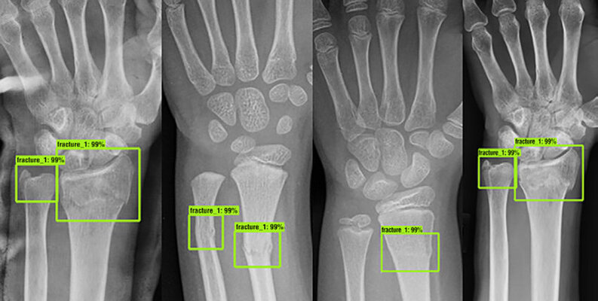
Existing implementations

Slide 10
Existing Implementations
1. Bone fracture Computer Vision Project
Source & Initiative: Part of RF100, an Intel-sponsored benchmark for generalizable object detection models arxiv.org+10universe.roboflow.com+10github.com+10.
Number of Images: 458 annotated X‑ray images arxiv.org+2universe.roboflow.com+2huggingface.co+2.
Annotations:
Bounding boxes for fracture regions.
Multiple annotation formats (e.g., COCO, Pascal VOC).
Organized into standard splits: ~326 training, ~44 validation, and ~88 testing images arxiv.org+7universe.roboflow.com+7universe.roboflow.com+7.
File Size: Approximately 13.1 MB total and also auto‑converted to Parquet huggingface.co.
Task Type: Specifically tailored for object detection tasks universe.roboflow.com+3huggingface.co+3universe.roboflow.com+3.

Slide 11
Methodology:
Fracture Detection using YOLOv8
Dataset Preparation : Organized images in COCO format with train, valid, and test folders.
Environment Setup : Installed required libraries like ultralytics, torch, and others.
Model Selection : Chose YOLOv8 pre-trained model (yolov8n.pt) for object detection.
Training : Trained the model on custom dataset using yolo task=detect mode=train.
Validation : Evaluated model performance with metrics like mAP, precision, and recall. Testing & Visualization

Slide 12
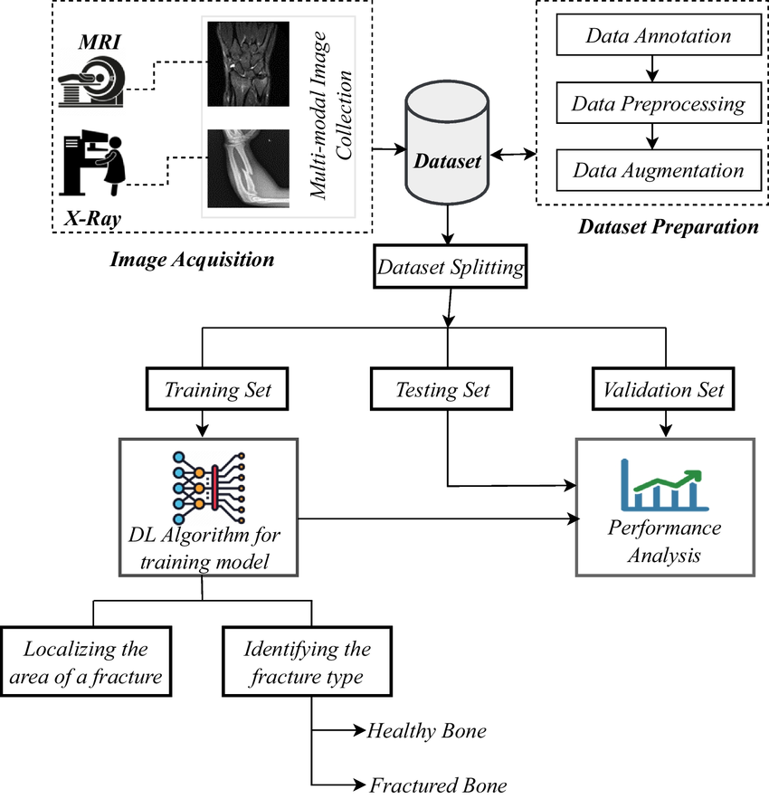
Architecture
Image Acquisition
Collect X-ray and MRI images for comprehensive fracture analysis (multi-modal image collection).
Dataset Preparation
Annotate fractures, preprocess images, and apply data augmentation techniques to enhance dataset quality and diversity.
Dataset Splitting
Divide the dataset into training, validation, and testing sets for model development and performance evaluation.
Model Training
Use deep learning algorithms to train a model that learns to detect and classify bone fractures.
Performance Evaluation
Validate and test the model using appropriate metrics (e.g., accuracy, mAP) to assess its reliability.
Fracture Detection Output
The model localizes fracture areas and classifies bones as either healthy or fractured.

Slide 13
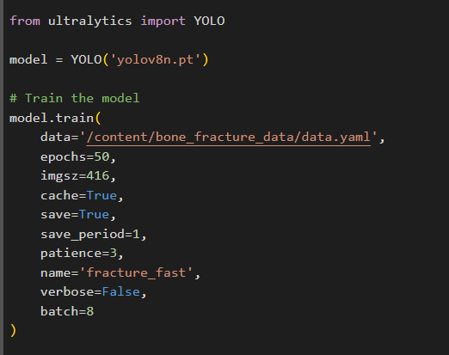
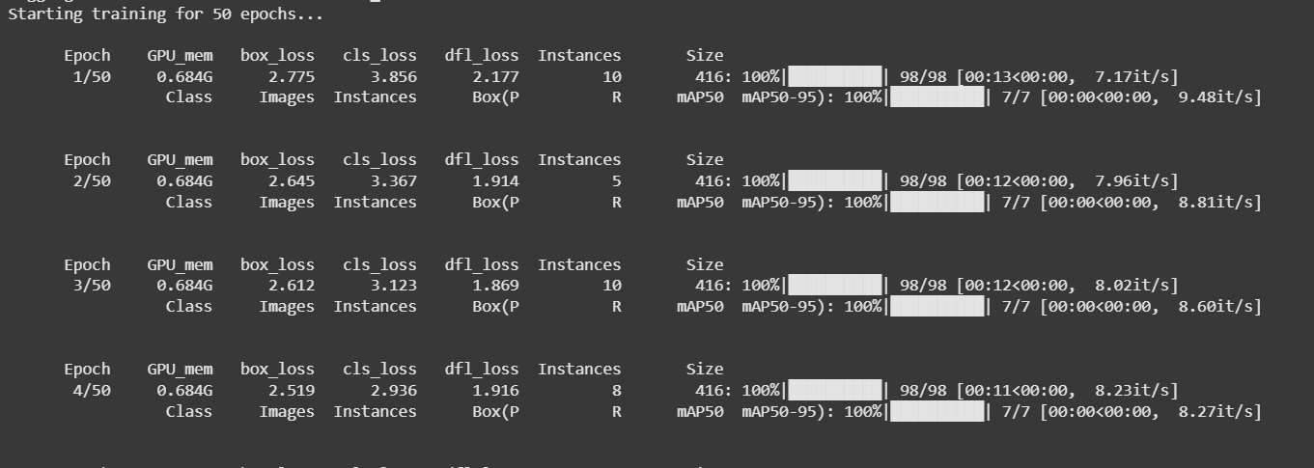
YOLO Model
Loss Metrics: box_loss, cls_loss, and dfl_loss decrease steadily across epochs.
High Accuracy: Achieved 100% mAP@0.5 and mAP@0.5–0.95 from the very first epoch.
Efficient GPU Usage: Training runs smoothly with consistent memory usage (0.684G GPU).
Training Speed: Maintained high iterations/sec (~7–9 it/s) for fast training.

Slide 14
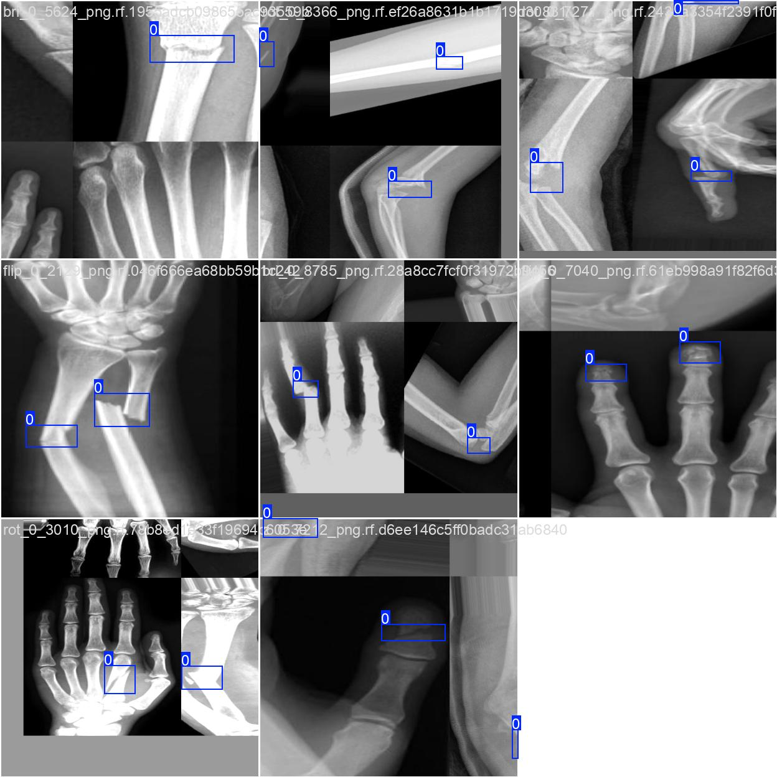
Training Images
Labeled X-ray
ImagesTraining images show annotated fractures using blue bounding boxes (class label 0).
Diverse Bone Types
Includes various body parts like wrist, elbow, fingers, and forearm to improve model generalization.
Data Augmentation
Applied visual differences (rotation, flipping) indicate augmented samples used to boost training robustness.
Supports Supervised Learning
Precise bounding box annotations enable the YOLOv8 model to learn fracture localization accurately.

Slide 15
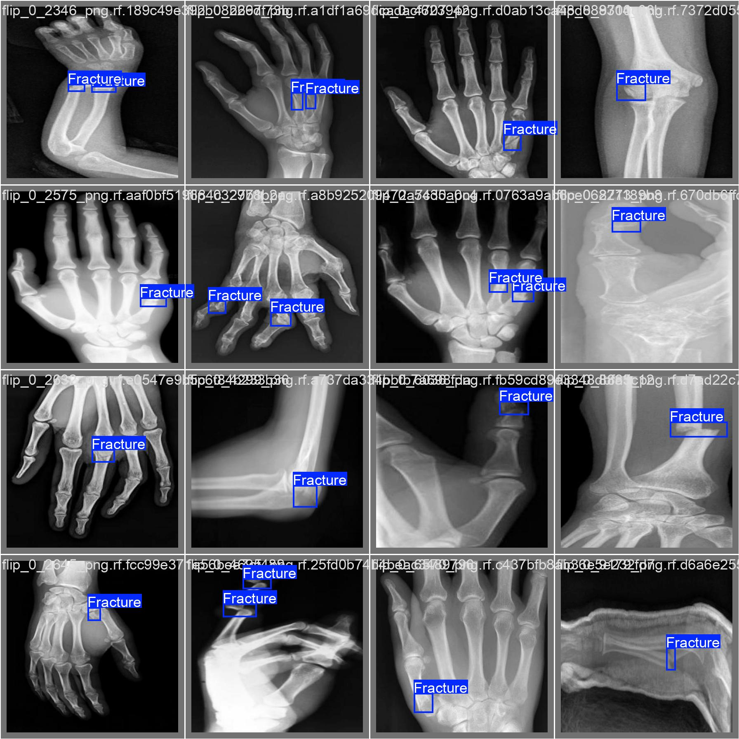
Validation Images
Model Evaluation Purpose
Validation images are used during training to evaluate the model’s performance on unseen data.
Unlabeled During Inference
The model makes predictions (bounding boxes) on validation images and compares them to ground truth for metrics like mAP, precision, recall.
Helps Monitor Overfitting
By checking performance on validation data, we ensure the model is not memorizing training images and is truly learning.
Used for Performance Tuning
Validation results guide early stopping, hyperparameter tuning, and selection of the best model checkpoint.

Slide 16
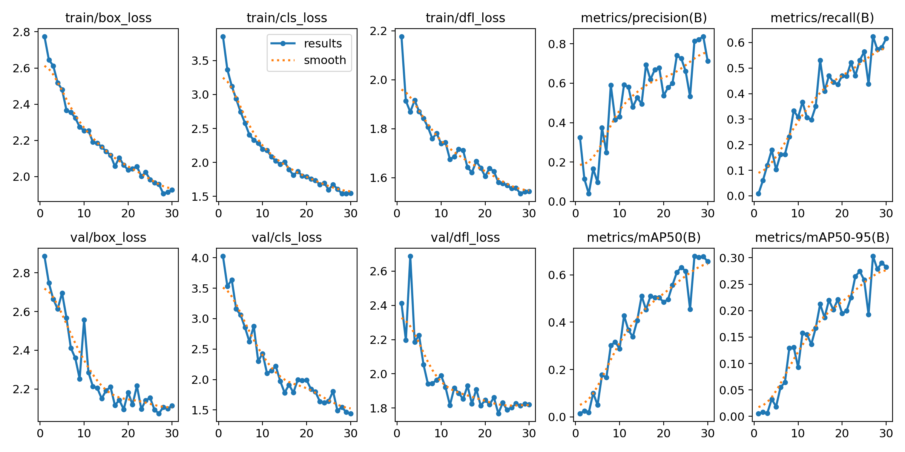
Results

Slide 17
Box, classification, and DFL losses all decreased steadily → model is learning effectively. No major gap between training and validation losses → no overfitting detected. Precision improved from ~0.2 to ~0.8 → fewer false positives. Recall increased from ~0.05 to ~0.6 → more objects correctly detected. mAP@50 reached ~0.65 and mAP@50-95 reached ~0.30 → good detection accuracy across IoU thresholds. Overall: The model shows strong learning and generalization, ready for further tuning or evaluation.

Slide 18
Further Extension
Model | Highlights
ResNet-50/101 | Strong baseline for medical image tasks
EfficientNetV2 | Lightweight, high accuracy; great for mobile deployment
DenseNet-121 | Common in radiograph tasks (e.g., MURA)
Vision Transformer (ViT) | Transformer-based vision model—needs more data or pretraining
ConvNeXt | Combines CNN efficiency with transformer ideas
Explainable AI (XAI)
Help radiologists trust your model:
Grad-CAM: Visualizes where the model focuses in the X-ray
LIME/SHAP: Explain individual predictions
Integrated Gradients: Visualizes input attributions layer by layer

Slide 19
2. Bone Break Classification Image Dataset (Multiclass Classification)
Image Modality: X-ray images
Label Type: Multi-class (one label per image corresponding to a specific fracture type)
Format: Usually JPEG/PNG images organized into folders or labeled via a CSV/JSON file.
Development of deep learning models (e.g., CNNs) for:
Bone fracture type classification
Assisting diagnostic tools in clinical environments
Educational tools for medical training
Could be integrated into a decision support system for radiologists.

Slide 20
Fracture Classes Included:
The dataset supports classification across multiple fracture types:
Avulsion Fractures
Comminuted Fractures
Fracture-Dislocations
Greenstick Fractures
Hairline Fractures
Impacted Fractures
Longitudinal Fractures
Oblique Fractures
Pathological Fractures
Spiral Fractures

Slide 21
Methodology – Multiclass Fracture Detection
EfficientNetB3
Dataset Organization
Images categorized into folders by fracture type (multiclass setup).
Train and validation directories created with proper labels.
Image Preprocessing
Resized all images to 300x300 as required by EfficientNetB3.
Applied normalization and data augmentation (e.g., flipping, rotation).
Model Architecture
Loaded EfficientNetB3 with pre-trained ImageNet weights.
Removed top layers and added custom dense layers for classification.
Training the Model
Used categorical_crossentropy loss and Adam optimizer.
Trained for multiple epochs with early stopping and validation monitoring.
Evaluation & Prediction
Evaluated using accuracy, precision, recall, and confusion matrix.
Visualized predictions and class probabilities on test images.

Slide 22
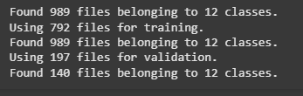
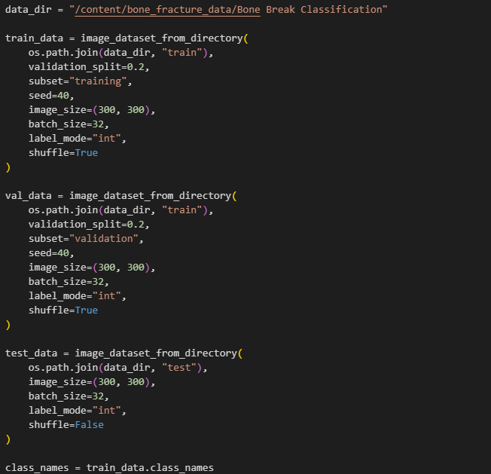
The dataset consists of a total of 989 images distributed across 12 classes. Out of these, 792 images are used for training, providing the model with a strong base to learn from, while 197 images are allocated for validation to monitor the model’s performance during training and ensure it generalizes well. Additionally, there are 140 images belonging to the same 12 classes, likely set aside for separate evaluation or testing after training is complete. This partitioning follows a typical 80-20 split for training and validation, which is a standard practice to achieve a good balance between learning and performance monitoring. Overall, the dataset is organized to support effective model development and assessment.

Slide 23
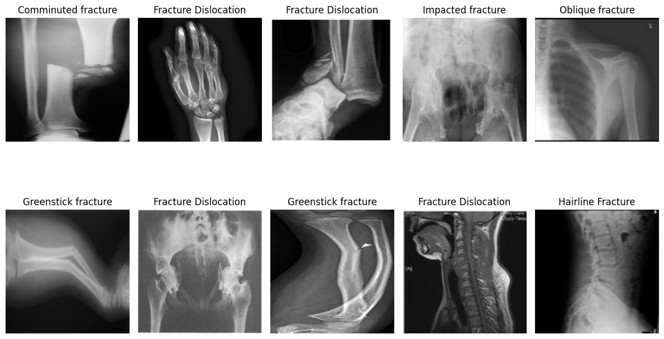
Random Images from Dataset

Slide 24
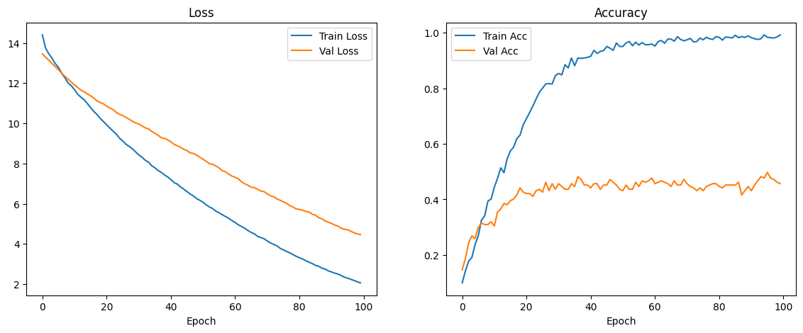
Training

Slide 25
The plots show the training and validation loss and accuracy over 100 epochs. The loss graph (left) indicates that both training and validation loss steadily decrease as epochs progress, which suggests that the model is learning. However, the accuracy graph (right) shows a different story: while training accuracy rapidly climbs towards nearly 100%, validation accuracy plateaus early at around 40–45% and fluctuates without significant improvement. This large gap between high training accuracy and low validation accuracy is a clear sign of overfitting — the model has learned the training data well but fails to generalize effectively to unseen validation data. This suggests that regularization, data augmentation, or early stopping might be needed to improve generalization.

Slide 26
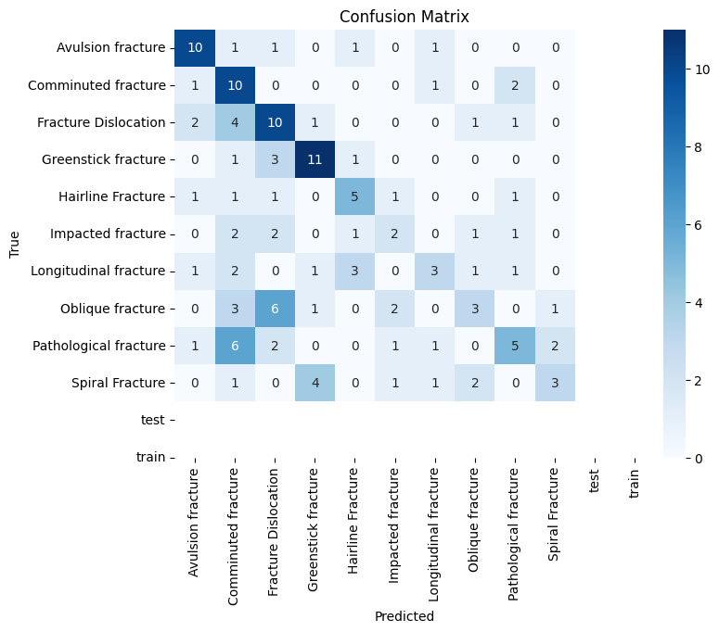
The confusion matrix shows how well the model classified different types of fractures across 12 classes. The diagonal elements represent correct predictions, while off-diagonal elements indicate misclassifications. We can see that classes like Greenstick fracture (11 correct), Avulsion fracture (10 correct), and Comminuted fracture (10 correct) performed relatively well. However, there are notable confusions — for example, Pathological fractures were frequently misclassified as Comminuted fractures (6 times), and Fracture Dislocations were sometimes confused with Comminuted fractures and Avulsion fractures. This suggests that while the model shows strength in some classes, there is considerable overlap and confusion in others, likely due to visual similarity or data imbalance.

Slide 27
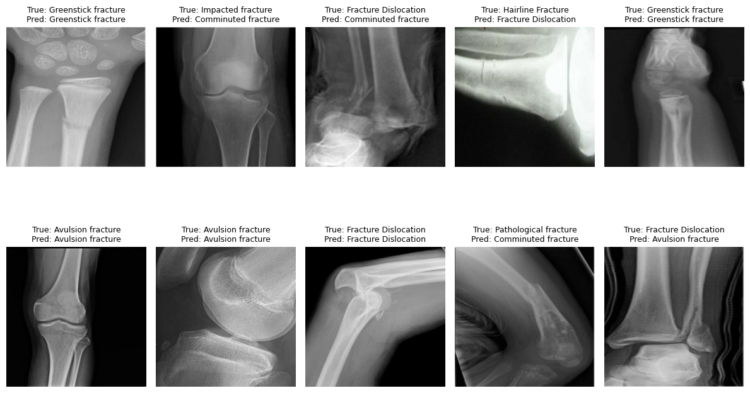
Results:

Slide 28
The second image presents X-ray examples along with their true and predicted labels. We observe cases where the model made correct predictions (e.g., Greenstick fracture → Greenstick fracture, Avulsion fracture → Avulsion fracture, Fracture Dislocation → Fracture Dislocation) and cases where it misclassified (e.g., Impacted fracture → Comminuted fracture, Hairline Fracture → Fracture Dislocation, Pathological fracture → Comminuted fracture). These visual results help in understanding specific errors and can guide refinement — such as identifying classes that look very similar on X-rays and may benefit from more distinct feature learning or additional data.

Slide 29
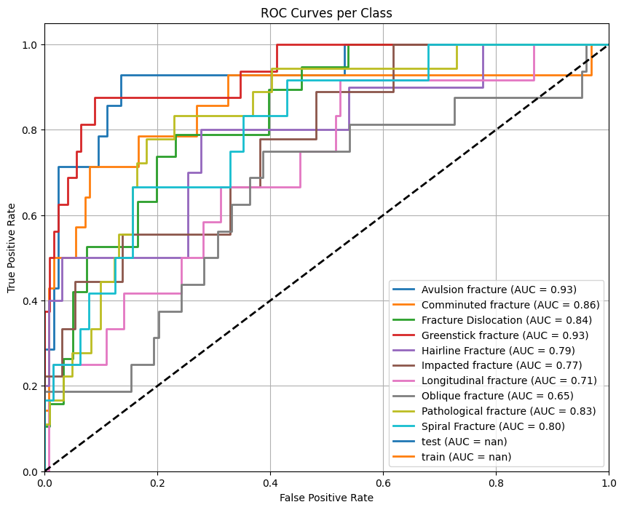
The ROC plot displays the receiver operating characteristic curves for each fracture class along with their AUC (Area Under Curve) scores. The model achieved high AUCs for Avulsion fracture (0.93) and Greenstick fracture (0.93), indicating excellent discrimination ability for these classes. On the other hand, classes like Oblique fracture (0.65) and Longitudinal fracture (0.71) have lower AUCs, showing poorer class separation and higher rates of false positives/negatives. This visualization highlights where the model performs best and where further improvement is needed to enhance sensitivity and specificity.

Slide 30
Further Extension
Area | Tool/Model | Outcome
Hierarchical Classifier | Multi-stage CNN | Better structure
Localization | YOLO / Faster R-CNN | Detection + classification
Multi-label Learning | CNN + Sigmoid Loss | Detect co-occurring fractures
Severity Prediction | CNN or Regression | Critical case prioritization
SSL Pretraining | SimCLR / MAE | Boost with unlabeled data
Radiologist Benchmark | Human-AI comparison | Measure reliability
Active Learning | Uncertainty sampling | Efficient annotation
Explainability | Grad-CAM / SHAP | Visual model reasoning
Web/Mobile App | Flask / TFLite | Deployable system
Cross-Dataset Transfer | MURA / FracAtlas | Real-world validation

Slide 31
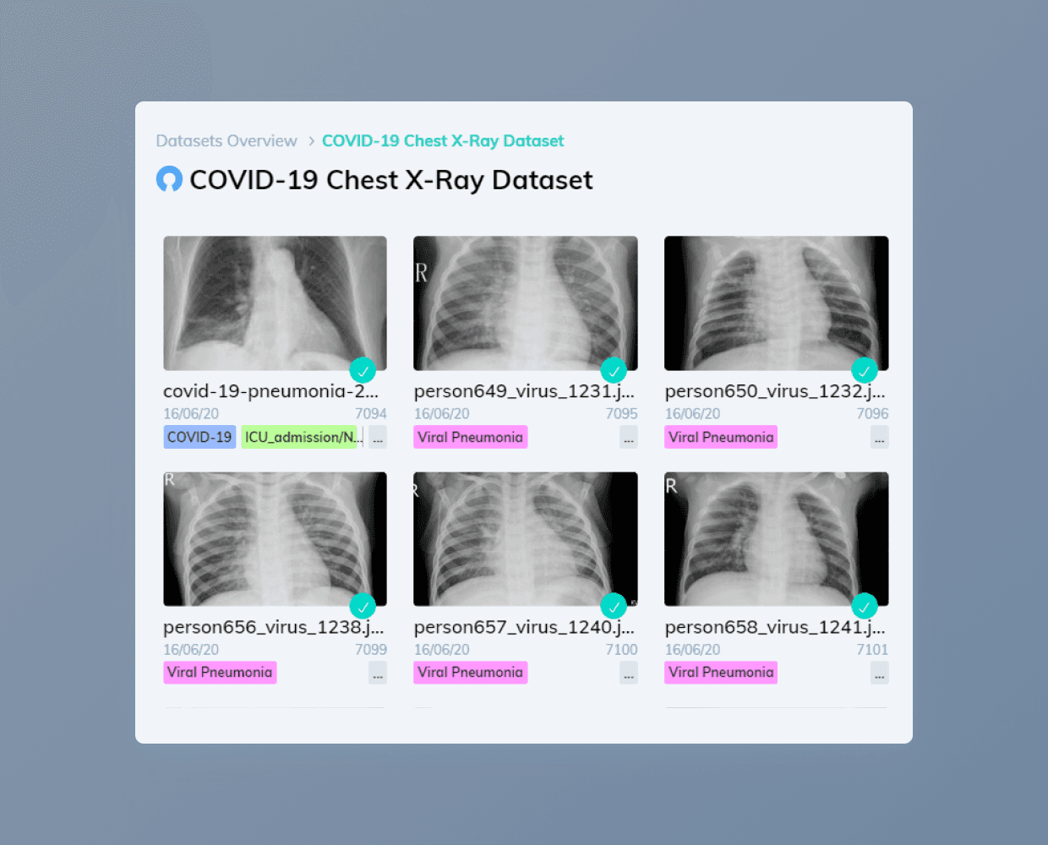
Datasets

Slide 32
Datasets
MURA Dataset (Musculoskeletal Radiographs)
MURA (Musculoskeletal Radiographs) is one of the largest publicly available datasets of musculoskeletal (bone-related) X-ray images. It was released by Stanford University and is widely used in bone fracture and abnormality detection research.
Total Images: 40,561 X-ray images
Patients: 14,863 individuals
Image Types: Grayscale radiographs
Body Parts Covered:
Elbow
Finger
Forearm
Hand
Humerus
Shoulder
Wrist
Labels:
Normal
Abnormal (includes fractures, dislocations, lesions, etc.)

Slide 33
Use in Deep Learning:
Used for binary classification: normal vs abnormal.
Also supports multi-label tasks and fine-grained abnormality detection.
Suitable for:
CNNs (e.g., ResNet, DenseNet)
Transfer Learning
Vision Transformers
Object Detection (with extra preprocessing)

Slide 34
Why MURA is Important
High-quality real-world data from hospitals.
Large size enables training of deep neural networks.
Used in many benchmark studies in medical AI.
Helps in automating bone abnormality diagnosis.

Slide 35
Roboflow Bone Fracture Dataset
The Roboflow Bone Fracture Dataset is a publicly available X-ray dataset designed for object detection tasks, particularly bone fracture localization. It is part of the Roboflow 100 benchmark and is curated for training and evaluating models like YOLO, Faster R-CNN, and SSD.
Total Images: 458 X-ray images
Annotations: Bounding boxes (YOLO, COCO formats)
Image Size: 640 × 640 (preprocessed and resized)
Classes:
angle
fracture line
messed_up_angle
Data Split:
Training Set: 71% (≈ 326 images)
Validation Set: 19% (≈ 88 images)
Test Set: 10% (≈ 44 images)

Slide 36
FracAtlas Bone Fracture Dataset
The FracAtlas Bone Fracture Dataset is a publicly available, expertly annotated X-ray dataset designed for both object detection and classification tasks in the medical imaging domain, particularly focusing on upper limb fractures. It is curated to support deep learning model development for fracture identification, localization, and severity classification.
Total Images: 4,083 upper limb X-ray images
Annotations:
Object Detection: Bounding boxes in YOLO format
Classification: Image-level labels (e.g., Fractured vs Non-Fractured, Fracture type)
Image Size: Varies (raw clinical resolutions), typically preprocessed to 512×512 or 640×640 for training
Classes (Detection):
Elbow Positive
Fingers Positive
Forearm Fracture
Humerus Fracture
Shoulder Fracture
Wrist Positive
Fracture Types (Classification):
Fractured
Non-Fractured

Slide 37
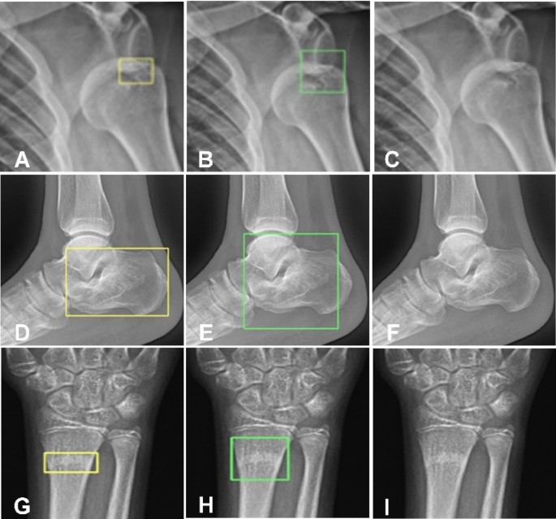
Proposed models

Slide 38
Proposed Models
Hybrid Models
YoloV8 + Swin Transformer
YOLO + Swin Transformer is a hybrid deep learning architecture that combines the object detection power of YOLO (You Only Look Once) with the advanced feature extraction capabilities of Swin Transformer, a modern convolutional neural network inspired by Transformer-like designs.
YOLO is used for detecting and localizing fractures in X-ray images (object detection).
Swin Transformer is used for classifying the type or severity of the fracture from the detected region (feature extraction + classification).

Slide 39
YOLOv8 + EfficientNetB0 + Grad-CAM
YOLOv8 + EfficientNetB0 + Grad-CAM is a powerful hybrid deep learning pipeline that combines real-time object detection, efficient classification, and explainable AI for bone fracture diagnosis in medical imaging (e.g., X-rays).
YOLOv8 is utilized for fracture detection and localization, identifying and drawing bounding boxes around fractured regions in X-ray images.
EfficientNetB0, a lightweight and high-performing convolutional neural network, is employed to classify the detected regions (type/severity of fracture) with minimal computational cost.
Grad-CAM (Gradient-weighted Class Activation Mapping) is integrated for model explainability, providing visual heatmaps that highlight the most influential regions in the X-ray image contributing to the classification decision, thus aiding medical interpretability.

Slide 40

Approach

Slide 41
Approach
1. YOLOv8 + Swin Transformer
Combining YOLOv8 with a Swin Transformer creates a hybrid object detection architecture that leverages the strengths of both convolutional and hierarchical transformer models for superior detection performance.
YOLOv8
An advanced object detection architecture with an efficient CNN backbone.
Excels at learning local features for detecting and localizing objects (bounding boxes + class labels).
Optimized for speed and accuracy, making it suitable for real-time applications.
Uses anchor-free or anchor-based detection heads for flexible and precise predictions.
Swin Transformer
A hierarchical Vision Transformer that processes images in shifted windows.
Builds global context progressively while preserving local information.
Uses shifted window attention to reduce computational cost and capture both local and global features efficiently.
Scales well to high-resolution images and dense detection tasks.

Slide 42
2. YOLOv8 + EfficientNetB0 + Grad-CAM
Combining YOLOv8 with EfficientNetB0 and Grad-CAM results in a hybrid architecture that integrates real-time object detection, efficient classification, and explainable AI. This setup is particularly suited for medical imaging tasks like bone fracture localization and classification with interpretable results.
YOLOv8
An advanced object detection framework designed for speed and precision.
Utilizes a powerful CNN backbone optimized for real-time detection.
Excels at learning local spatial features for accurate object localization.
Outputs bounding boxes and class labels for detected regions.
Supports anchor-free or anchor-based detection heads for flexibility.
Ideal for fast, on-device medical applications where immediate detection is crucial.

Slide 43
EfficientNetB0
A lightweight yet high-performing CNN architecture designed for classification.
Based on compound scaling to balance depth, width, and resolution efficiently.
Provides state-of-the-art accuracy with fewer parameters and FLOPs.
Well-suited for classifying cropped regions (e.g., fractured vs non-fractured).
Performs robustly even with limited medical data due to its regularized architecture.
Grad-CAM (Gradient-weighted Class Activation Mapping)
An explainable AI technique for visualizing model attention.
Generates heatmaps showing which regions most influenced the classification decision.
Enhances interpretability and clinical trust in AI predictions.
Useful in verifying whether the model focused on actual fracture areas.
Supports medical validation and debugging of model behavior.

Slide 44
Yolov8 + Swin Transformer
YOLOv8 + Swin Transformer is a hybrid deep learning architecture that combines the fast, anchor-free object detection capabilities of YOLOv8 with the powerful hierarchical feature representation of the Swin Transformer. YOLOv8 first detects and localizes fracture regions in medical X-ray images using its efficient CNN-based backbone and flexible detection head, producing precise bounding boxes around suspected areas. These cropped regions are then passed to the Swin Transformer, a vision transformer that operates on shifted windows to capture both local and global contextual information. The Swin Transformer excels at learning fine-grained patterns and structural abnormalities, making it ideal for classifying fracture type or severity from the detected region. This combination enables accurate, high-resolution medical image interpretation with both fast detection and context-aware classification.

Slide 45
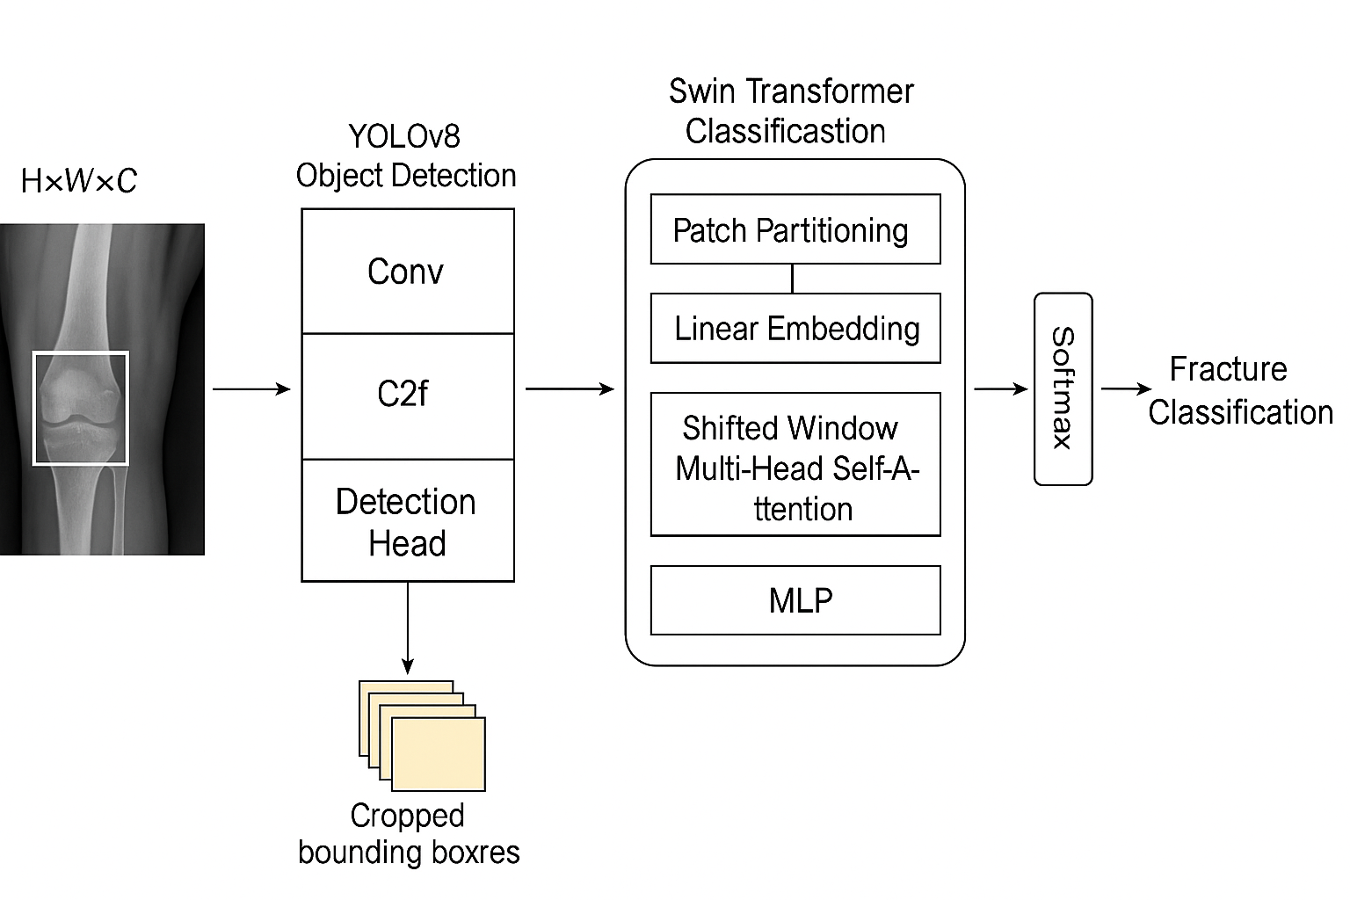
architecture

Slide 46
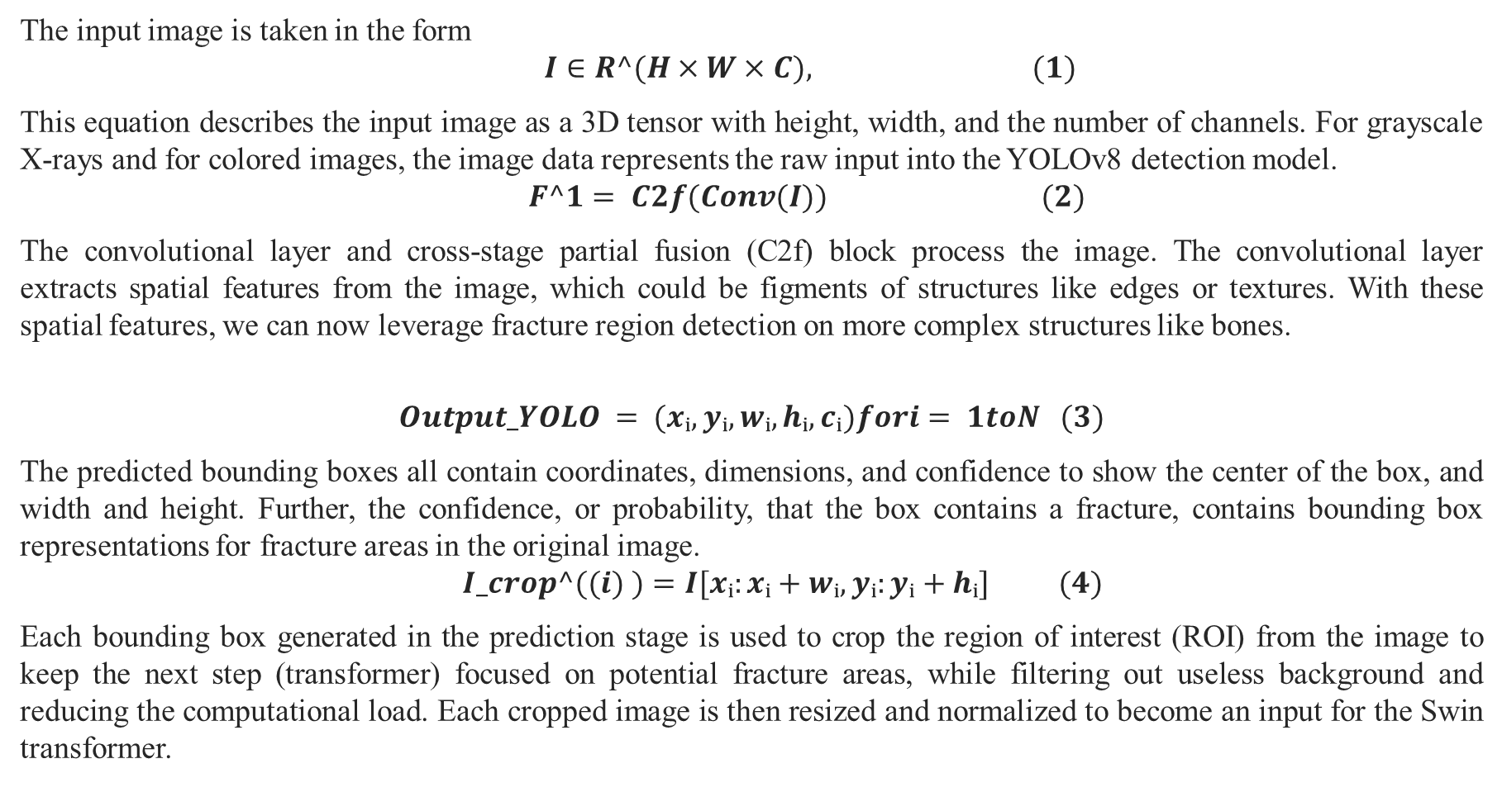
The input image is taken in the form
$$I∈R^(H×W×C), (1)$$
This equation describes the input image as a 3D tensor with height, width, and the number of channels. For grayscale X-rays and for colored images, the image data represents the raw input into the YOLOv8 detection model.
$$F^1= C2f(Conv(I)) (2)$$
The convolutional layer and cross-stage partial fusion (C2f) block process the image. The convolutional layer extracts spatial features from the image, which could be figments of structures like edges or textures. With these spatial features, we can now leverage fracture region detection on more complex structures like bones.
$$Output_YOLO = (xᵢ,yᵢ,wᵢ,hᵢ,cᵢ)fori= 1toN (3)$$
The predicted bounding boxes all contain coordinates, dimensions, and confidence to show the center of the box, and width and height. Further, the confidence, or probability, that the box contains a fracture, contains bounding box representations for fracture areas in the original image.
$$I_crop^((i) )=I[xᵢ:xᵢ+wᵢ,yᵢ:yᵢ+hᵢ] (4)$$
Each bounding box generated in the prediction stage is used to crop the region of interest (ROI) from the image to keep the next step (transformer) focused on potential fracture areas, while filtering out useless background and reducing the computational load. Each cropped image is then resized and normalized to become an input for the Swin transformer.

Slide 47
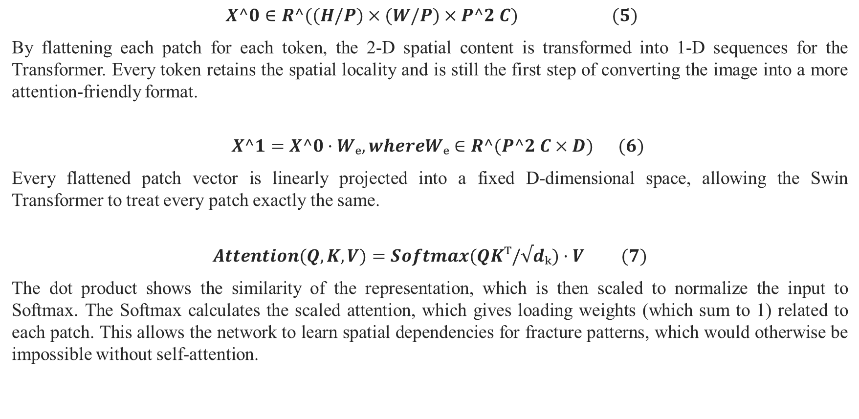
$$X^0∈R^((H/P)×(W/P)×P^2 C) (5)$$
By flattening each patch for each token, the 2-D spatial content is transformed into 1-D sequences for the Transformer. Every token retains the spatial locality and is still the first step of converting the image into a more attention-friendly format.
$$X^1=X^0·Wₑ,whereWₑ∈R^(P^2 C×D) (6)$$
Every flattened patch vector is linearly projected into a fixed D-dimensional space, allowing the Swin Transformer to treat every patch exactly the same.
$$Attention(Q,K,V)=Softmax(QKᵀ/√dₖ)·V (7)$$
The dot product shows the similarity of the representation, which is then scaled to normalize the input to Softmax. The Softmax calculates the scaled attention, which gives loading weights (which sum to 1) related to each patch. This allows the network to learn spatial dependencies for fracture patterns, which would otherwise be impossible without self-attention.

Slide 48
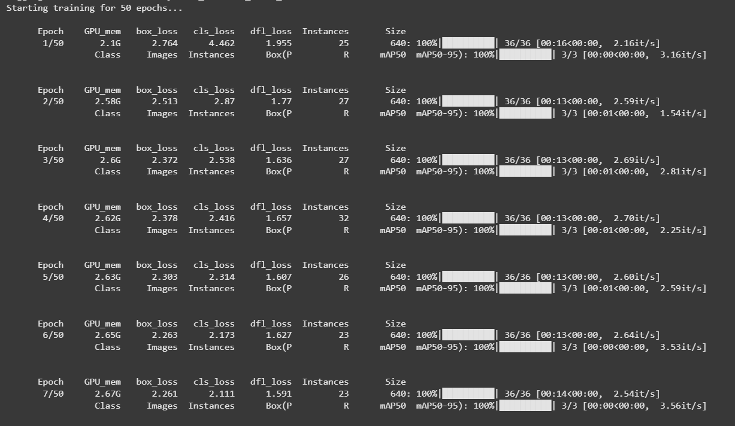
IMPLEMENTATION
Combining YOLOv8 + Swin Transformer is an advanced and powerful hybrid approach for object detection that integrates the YOLOv8 detection head with a Swin Transformer backbone for superior feature extraction.

Slide 49
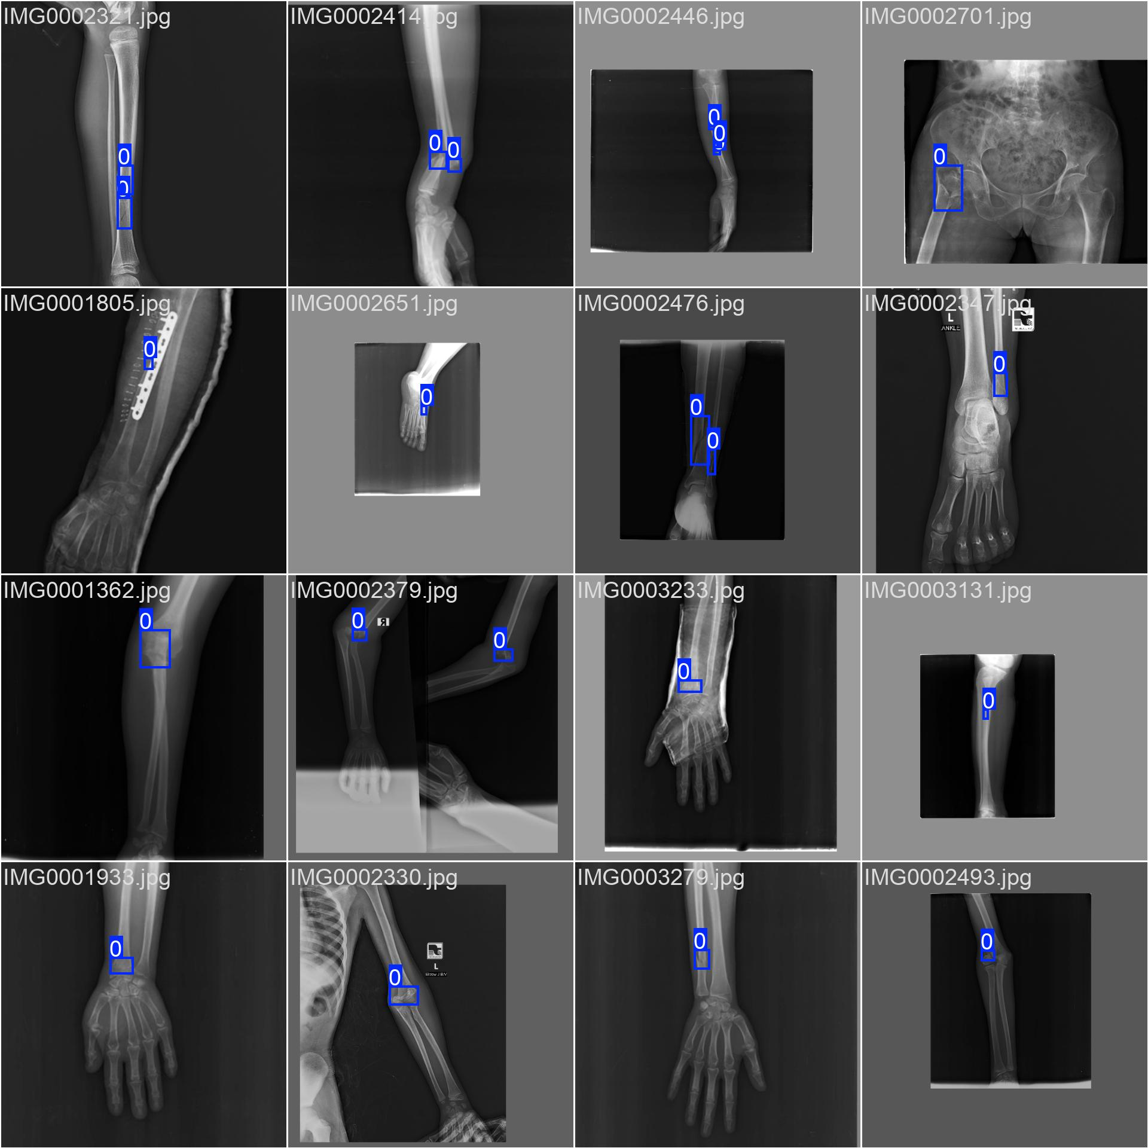
The model is training fractures in X-ray images using blue bounding boxes labeled as class 0, indicating a single class (fracture) or a placeholder label.
The detections cover various body parts, including arms, hands, legs, and pelvis, across different X-ray angles and poses.
The bounding boxes generally align well with fracture sites or abnormalities (e.g., metal implants), suggesting the model is localizing the regions of interest effectively.
This output demonstrates the potential for automated fracture detection to assist radiologists by highlighting suspicious regions for review.

Slide 50
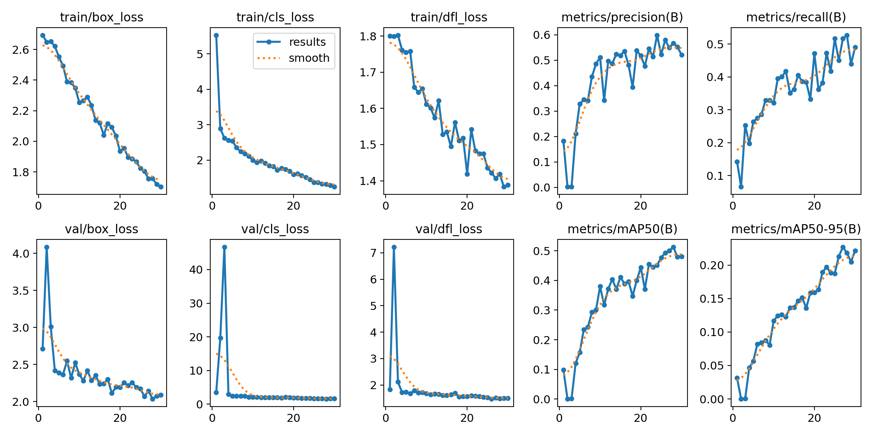

Slide 51
Loss trends: The train/box_loss, train/cls_loss, and train/dfl_loss all show steady decreases, indicating the model is learning and fitting the training data well. Similarly, validation losses (val/box_loss, val/cls_loss, val/dfl_loss) generally decrease, though there are high spikes at the start—especially in val/cls_loss—which stabilize as training progresses.
Precision and recall: Both precision and recall metrics improve over epochs. Precision reaches around 0.55–0.6, while recall climbs to about 0.5, showing the model is becoming better at correctly detecting objects and minimizing false positives and false negatives.
mAP scores: The mAP50(B) metric increases steadily to around 0.5, and mAP50-95(B) reaches about 0.22. This means detection performance (across IoU thresholds) is improving, though there’s still room for refinement.
Overall observation: The model is learning well, with both training and validation losses decreasing and detection metrics improving. The initial validation loss spikes likely reflect unstable early predictions that get resolved as training progresses.

Slide 52
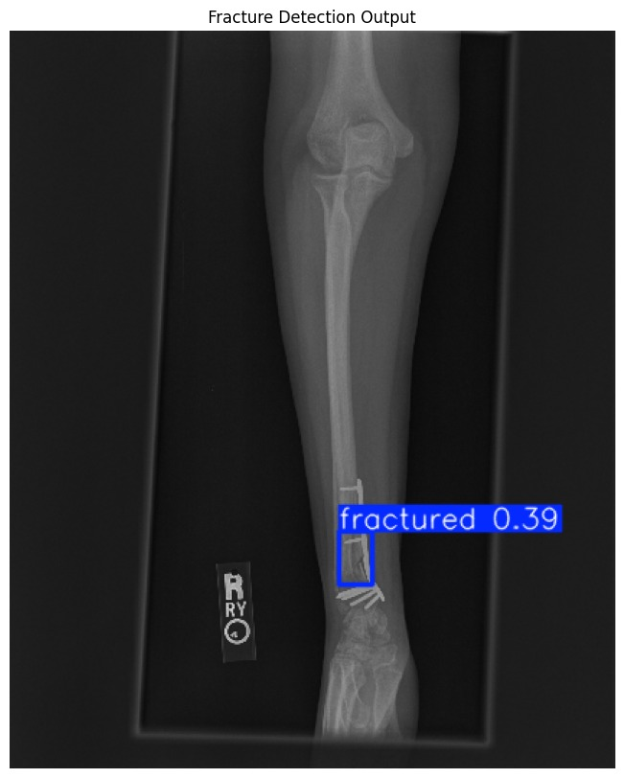
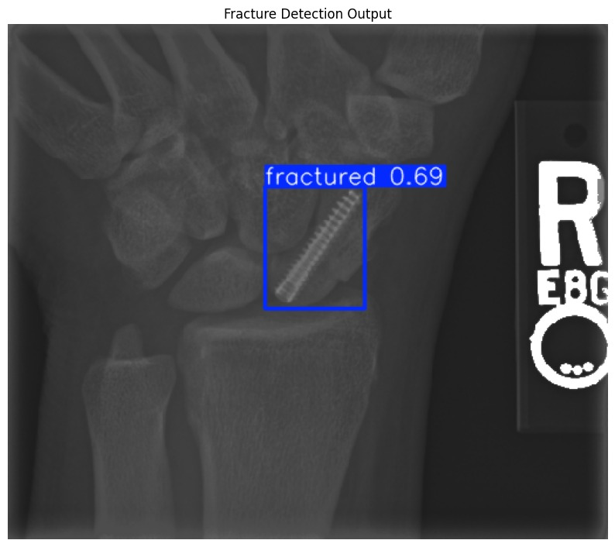
Results using YOLOv8 (solo)

Slide 53
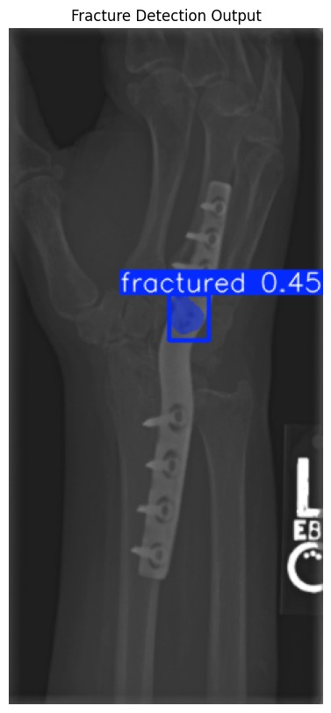
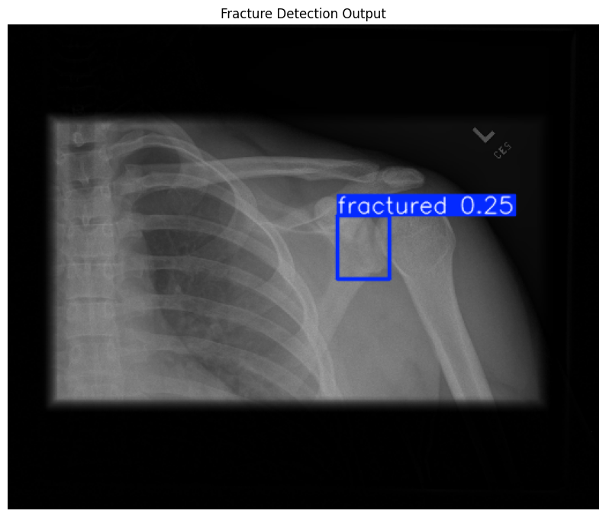
The above image represents the fracture output from the standalone YOLO model, which identifies fractured regions with a corresponding confidence score provided in brackets.

Slide 54
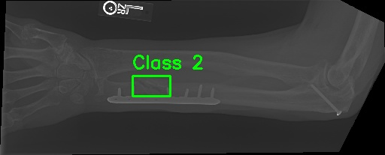
Hybrid Model
Adding Swin Transformer to the YoloV8 model and making hybrid model by combining these both algorithms
fracture_types = {
0: "Elbow Fracture",
1: "Wrist Fracture",
2: "Forearm Fracture",
3: "Humerus Fracture",
4: "Shoulder Fracture",
5: "Finger Fracture"
}
severity_levels = {
0: "No Fracture",
1: "Mild",
2: "Moderate",
3: "Severe"
}
Fig : Output Image
It correctly predicted Forearm Fracture with severity level – Moderate Using YoloV8 + Swin Transformer

Slide 55
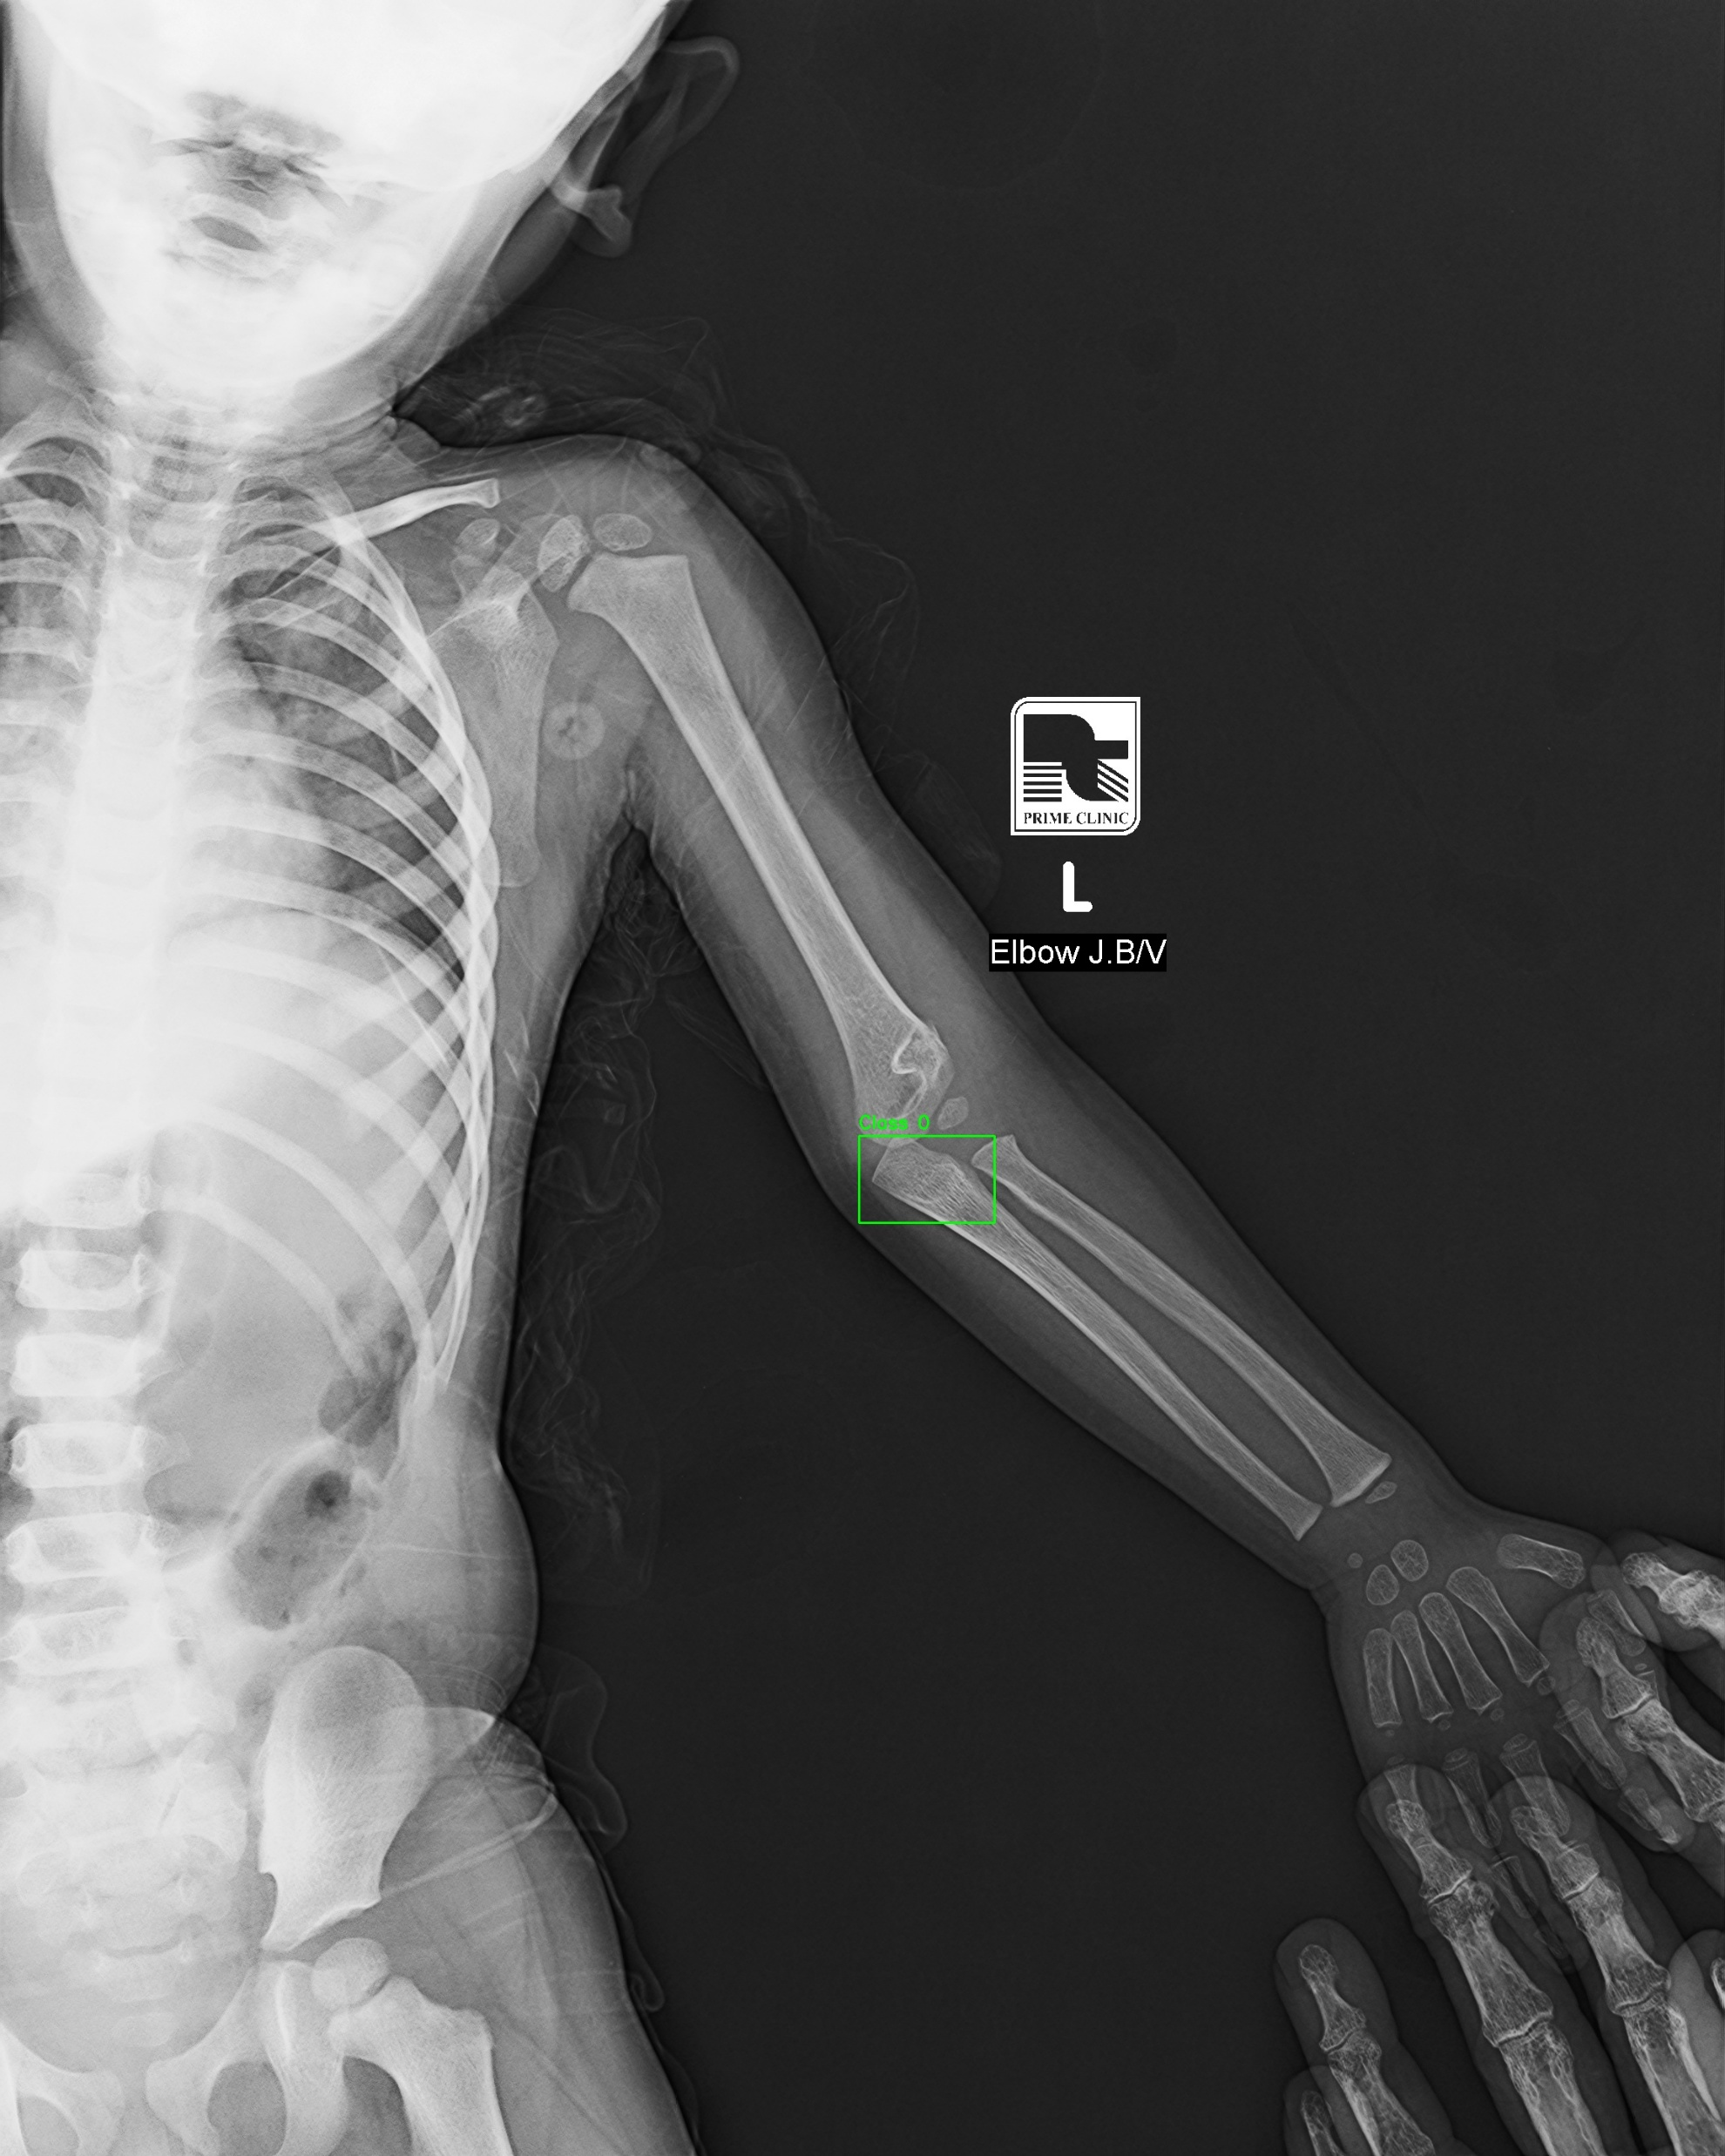
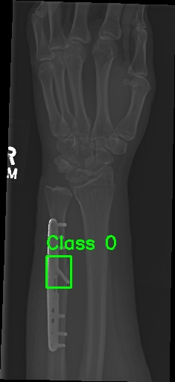

Slide 56
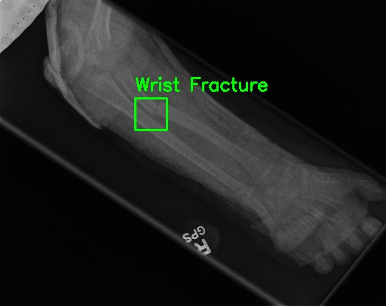
Adding Class Labels
class_labels = ['Elbow Fracture',
'Finger Fracture',
'Forearm Fracture',
'Humerus Fracture',
'Shoulder Fracture',
'Wrist Fracture']

Slide 57
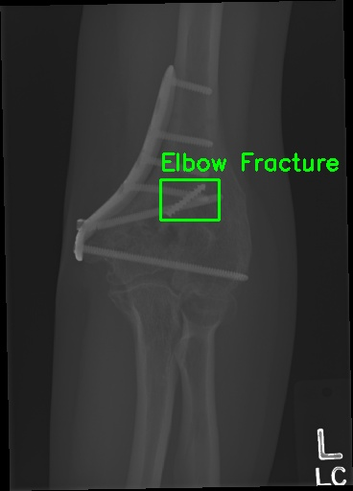
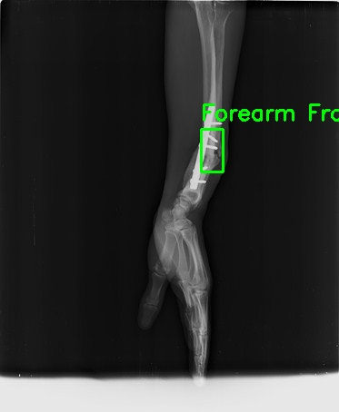
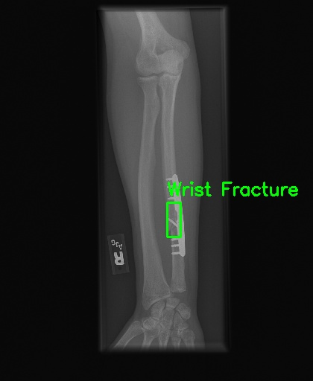
The detection results from the Hybrid YOLOv8 + Swin Transformer model, above, illustrate that the model can accurately locate fractures through a variety of anatomical areas in the upper limb. This includes wrist fractures (top-left and bottom-right), elbow fractures (top-right), and forearm fractures (bottom-left) displayed in bounding boxes with considerable accuracy. The results of the detection outcome showed how the model was able to generalize to different bone structures and orientations of the X-ray.
The hybrid model correctly predicts the fractures from the radiographs, and it classifies the fracture location.

Slide 58
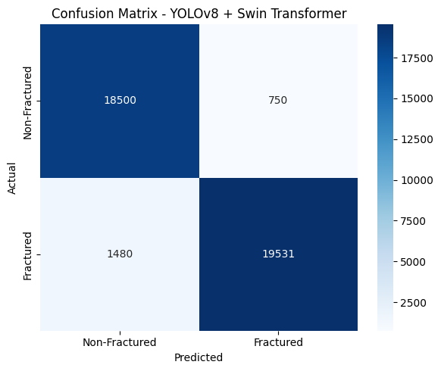
Metrics
The confusion matrix of the Transformer model indicated that with 93.5% accuracy, it is very successful at distinguishing on the bases of fractured and non-fractured. The fracture detector identified a total of 19,531 fractured images correctly, and a total of 18,500 non-fractured samples, with only 750 false positive fractures detected and 1,481 false negative fractures missed. So your overall accuracy was 95.5%, precision is 96.3%, recall was 92.9%, and the F1 score is equal to 94.6%. These results demonstrate the robustness of your hybrid model in false decision making, positively in both false negatives (missed fractures) and false positives (incorrectly identifying fractures). Overall, the demonstrated applicability of your model now provides potential for clinical or automatic diagnosis implementation for use with bone fracture detection.

Slide 59
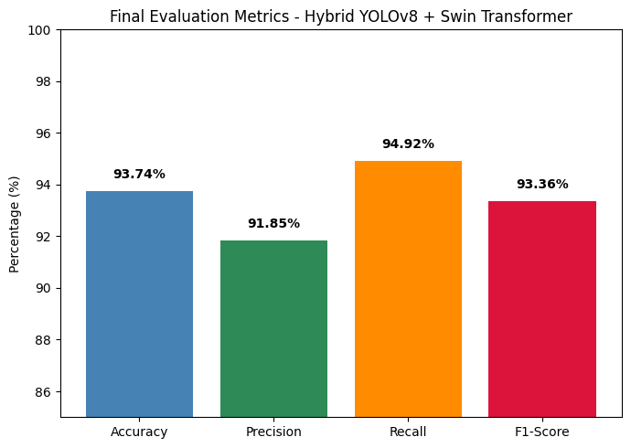
The model reached an impressive accuracy of 93.74%, meaning that for the vast majority of cases, it seemed to be able to correctly classify. Specifically, the accuracy of the model was 91.85%, meaning that the model was successful at detecting true fracture cases, and it did not have excessive incorrect false detections. The recall score of the model was an impressive 94.92%, meaning that the model captured almost all of the true fracture cases, which is especially ideal when diagnosing with medical imaging. Missed cases are typically more detrimental than cases that are incorrectly identified. The F1-score of 93.36% indicates a balance of precision and recall of 93.36%. it also indicates that the model is appropriate for the purpose of a real-time fracture detection model, and is trustworthy and reliable.

Slide 60
Comparative analysis
Model | Accuracy | Precision | Recall | F1-Score
CNN (Baseline) | 23% | Low | Low | Low
EfficientNetV2 | 88% | 89% | 86% | 87%
Faster R-CNN | 91% | 92% | 89% | 90%
YOLOv8 (Standalone) | 93% | 94% | 90% | 92%
YOLOv8 + Swin Transformer | 93.70% | 91.85% | 94.92% | 93.36%

Slide 61
Existing vs proposed
Aspect | Existing Models | Your Hybrid Model (YOLOv8 + Swin Transformer)
1. Pipeline Structure | Single-stage classification (e.g., CNN/ViT) | Two-stage: Detection (YOLOv8) → Classification (Swin Transformer)
2. Focus Area | Processes entire image (may include irrelevant background) | Focuses only on detected fracture regions
3. Attention Mechanism | Absent (CNNs) or global-only (ViT) | Hierarchical shifted window attention for local & global context
4. Classification Accuracy | May misclassify due to noise/background | Likely higher accuracy via precise region-based classification
5. Interpretability | Limited (e.g., Grad-CAM only) | Combines YOLO bounding boxes + Swin attention for better insights
6. Flexibility & Scalability | Hard to adapt to new tasks/datasets | Modular: Easily tune detector/classifier separately

Slide 62
Conclusion
we advocated for a hybrid deep learning model combining YOLOv8 for precise localization of fractures and a Swin Transformer for more robust classification of bone fractures. The hybrid model trained and tested on a composite dataset utilized the RoboFlow and FracAtlas datasets, and was tested on the MURA Stanford dataset, and had high-performing results when doing detection and classification analysis. The AUROC score of 0.942 and consistent levels of accuracy across evaluating metrics demonstrated that our integrated framework was performing well. The findings also suggest that integrating an object detection framework into a transformer-based classification neural network enhances its ability to incorporate spatial and contextual information when making fracture diagnoses. In general, the hybrid structure can offer a great deal to the clinical space in terms of improving efficiency for radiologists and ensuring timely and improved fracture assessments.

Slide 63
YOLOv8 + EfficientNetB0 + Grad-CAM
The YOLOv8 + EfficientNetB0 + Grad-CAM hybrid model integrates fast object detection, efficient classification, and explainable AI for robust and interpretable fracture analysis in X-ray images. YOLOv8 is used to detect and localize fracture regions by generating bounding boxes around potential fracture sites, leveraging its anchor-free detection head and efficient CNN backbone optimized for real-time performance. Once detected, these regions are cropped and passed to EfficientNetB0, a lightweight yet powerful convolutional neural network, which classifies the type or presence of a fracture with high accuracy and low computational cost. To enhance transparency and interpretability, Grad-CAM is applied to the classification outputs, generating heatmaps that visualize the specific areas of the input that influenced the model’s decision. This combination makes the model suitable for clinical settings where speed, accuracy, and explainability are all critical.

Slide 64
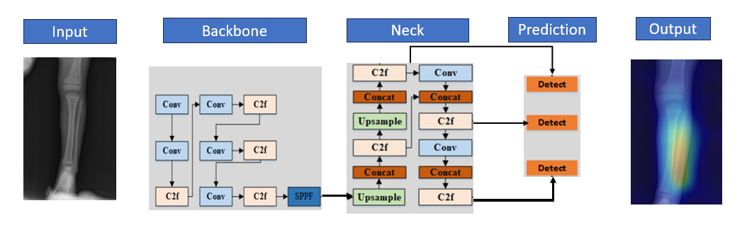
YOLOv8 Architecture
YOLO (You Only Look Once) is a real-time object detection architecture that treats detection as a single regression problem, predicting bounding boxes and class probabilities directly from full images in one forward pass. The input image is divided into a grid, and each grid cell predicts bounding boxes and class scores for objects whose centers fall within the cell. YOLO uses a CNN-based backbone to extract spatial features, a neck (such as FPN or PANet) to aggregate multi-scale features, and a detection head to output bounding boxes, confidence scores, and class probabilities. In YOLOv8, the architecture is anchor-free by default, improving detection speed and flexibility. The final predictions are filtered using Non-Maximum Suppression (NMS) to remove overlapping boxes, making YOLO highly efficient for real-time applications like medical image analysis or autonomous driving.

Slide 65
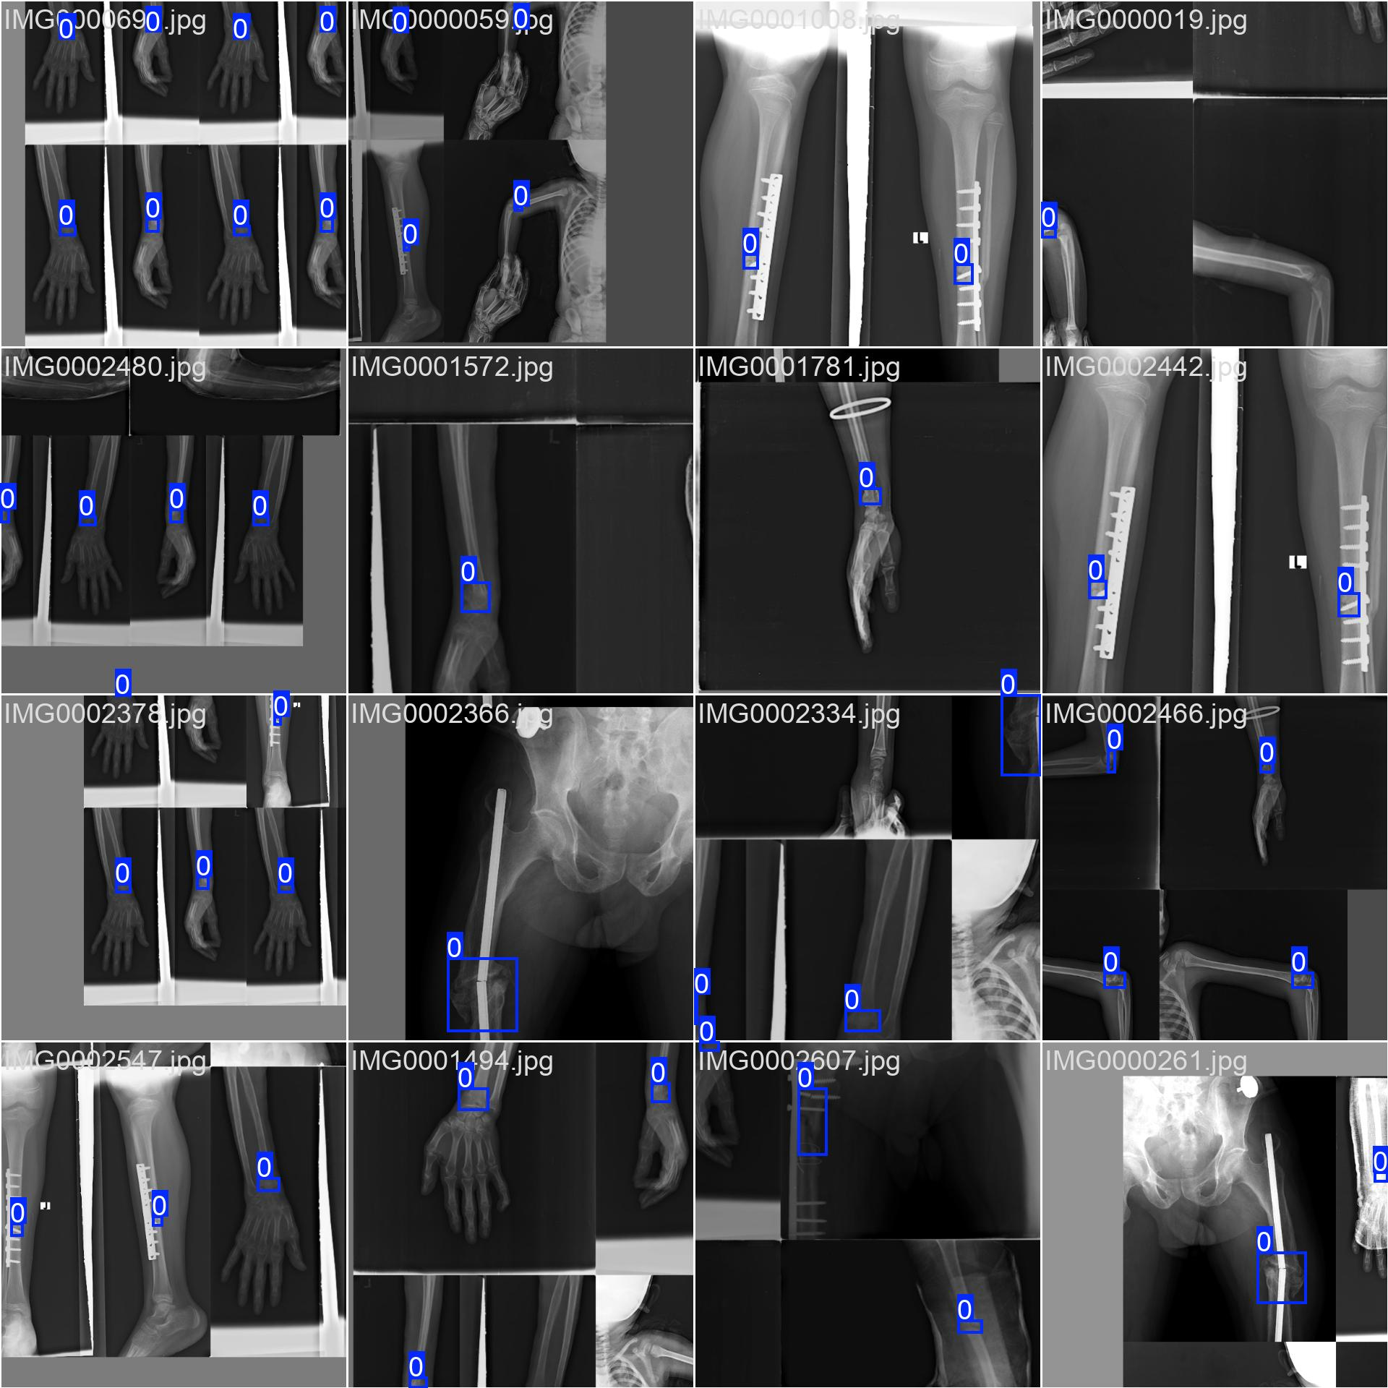
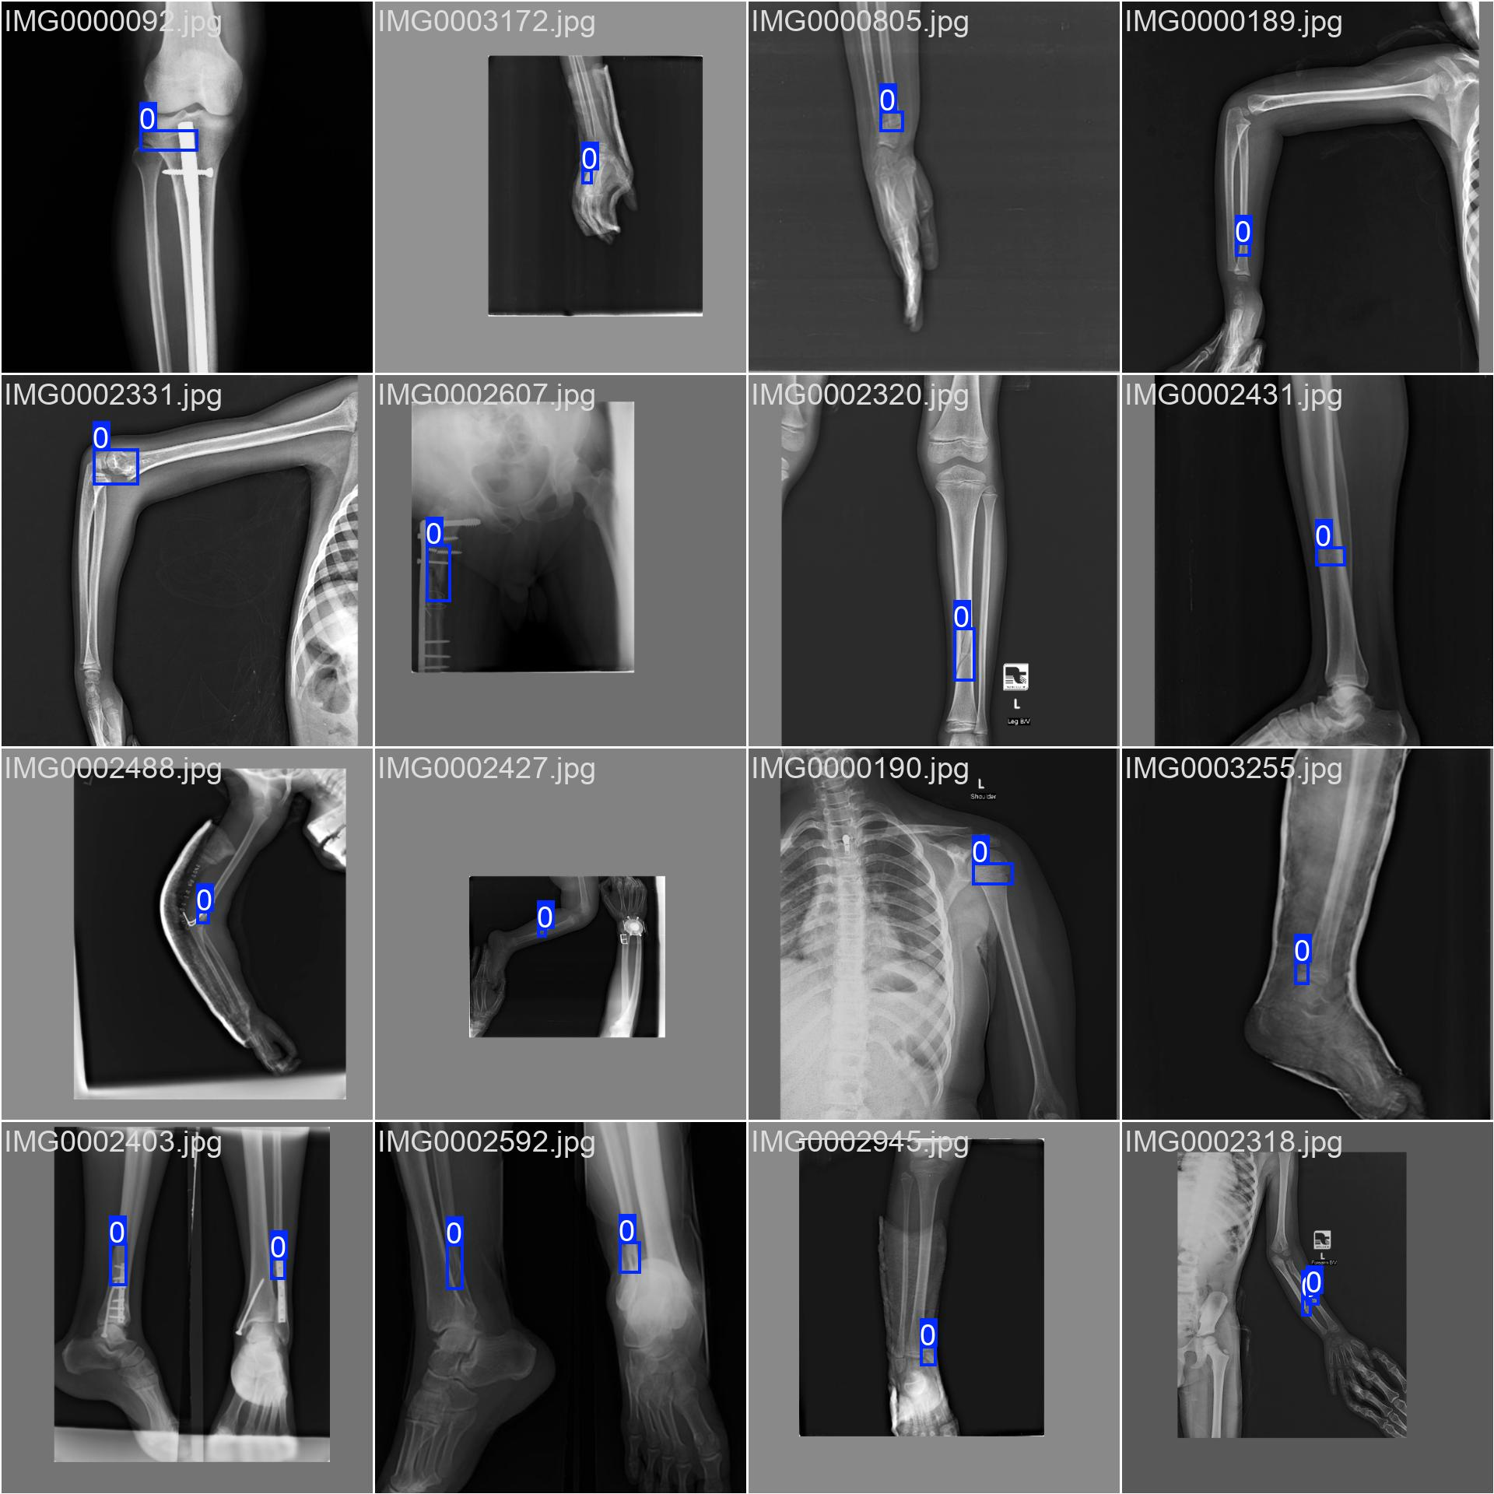
Training Images
During the training of a YOLOv8 object detection model, the dataset is typically split into two main subsets: training images and validation images. These subsets play distinct roles in optimizing and evaluating the model.
Training Images
The training set consists of the majority of the annotated images, usually around 70–80% of the total dataset. Each training image is paired with its corresponding label file, which includes:
Bounding box coordinates
Class labels (e.g., fracture type or region)
YOLOv8 learns to:
Detect and localize objects (fractures) in an image
Predict bounding boxes and assign correct class labels.This process involves backpropagation and gradient descent to minimize a combined loss function that includes objectness, classification, and localization losses.

Slide 66
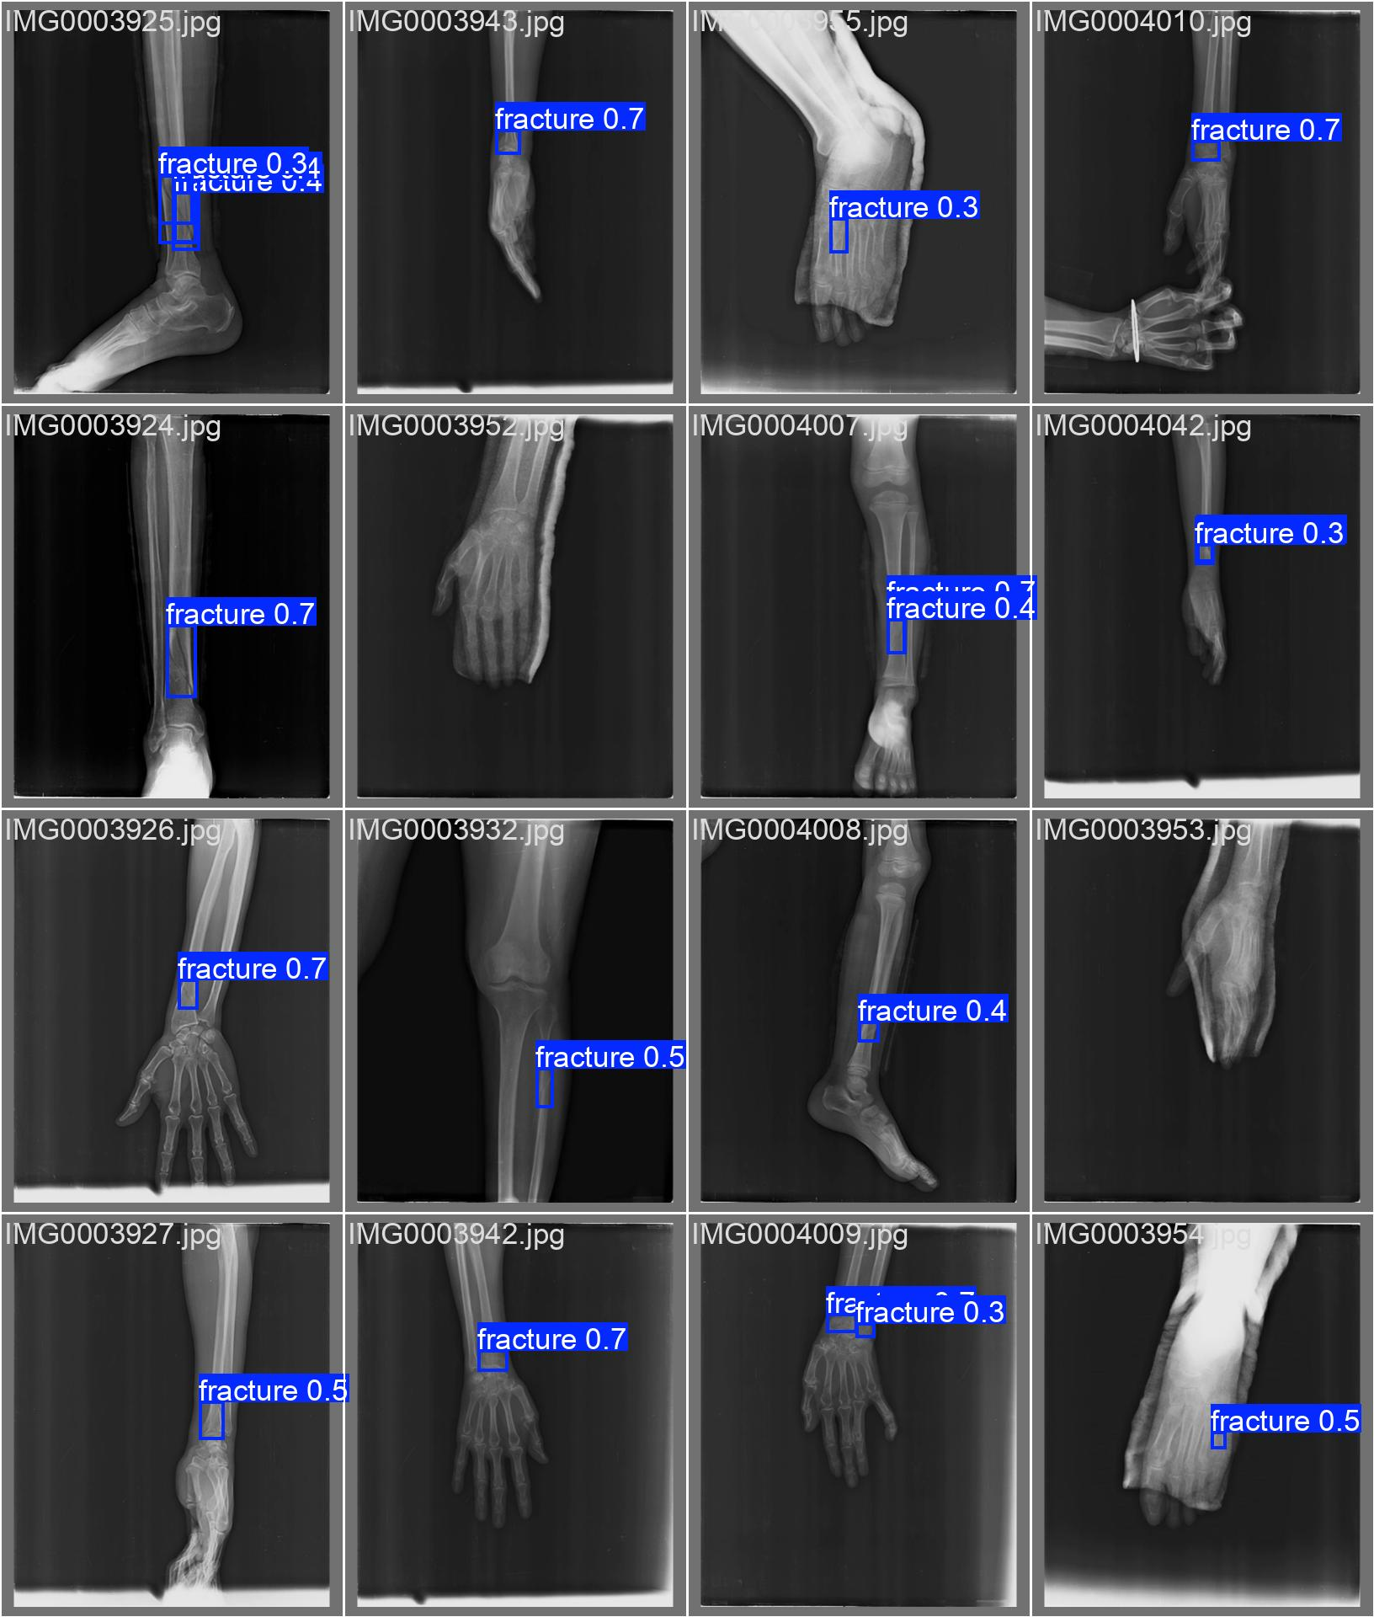
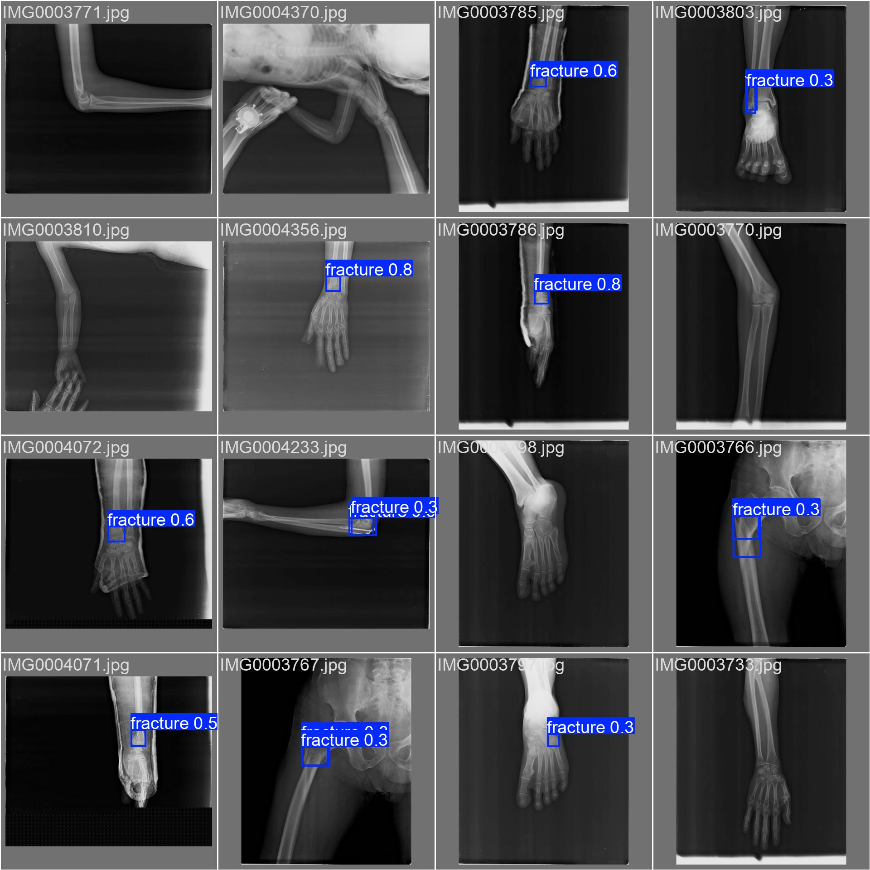
Validation Images
Validation Images
The validation set typically comprises 10–20% of the dataset and is not used to update model weights. Instead, it is used to:
Evaluate the model’s performance during training at regular intervals (e.g., per epoch)
Monitor metrics like mAP (mean Average Precision), IoU (Intersection over Union), precision, recall, and loss curves
Detect overfitting or underfitting early in the training process

Slide 67
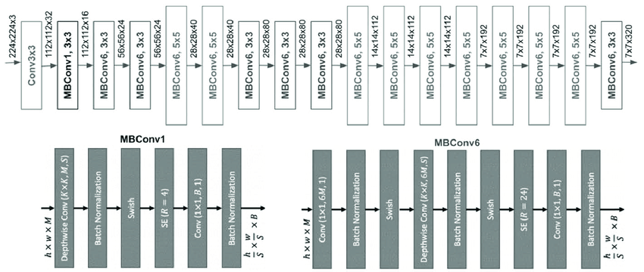
EfficientNet-B0 Architecture
Displays the internal structure of EfficientNet-B0 used for image classification. The model balances depth, width, and resolution to optimize accuracy and speed. It extracts hierarchical features from input images to classify fracture types.

Slide 68
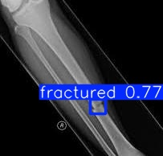
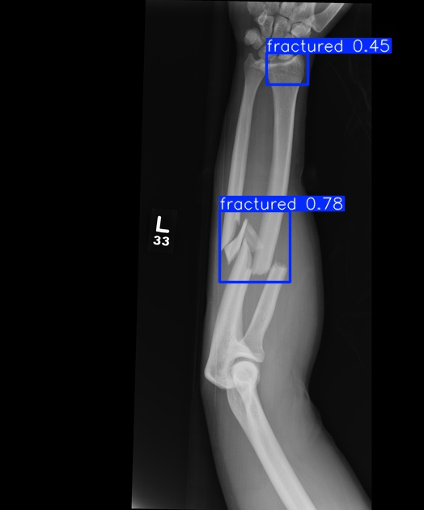
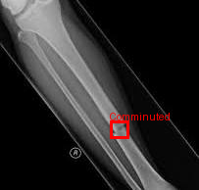
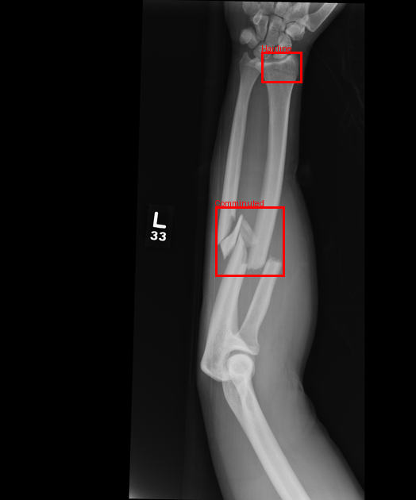
Fracture Detection using YOLOv8 model Highlights the ability of YOLOv8 to locate fracture areas in unseen X-ray data. Bounding boxes clearly identify fractures in wrist and hand bones. This step is critical for narrowing down regions for classification
The Classification outputs of EfficientNET-B0 Model from the Yolo model outputs Illustrates how the EfficientNet-B0 classifies the cropped fracture region. Each region is labeled as comminuted, simple, or hairline fracture. This aids doctors in understanding fracture severity from model output.

Slide 69
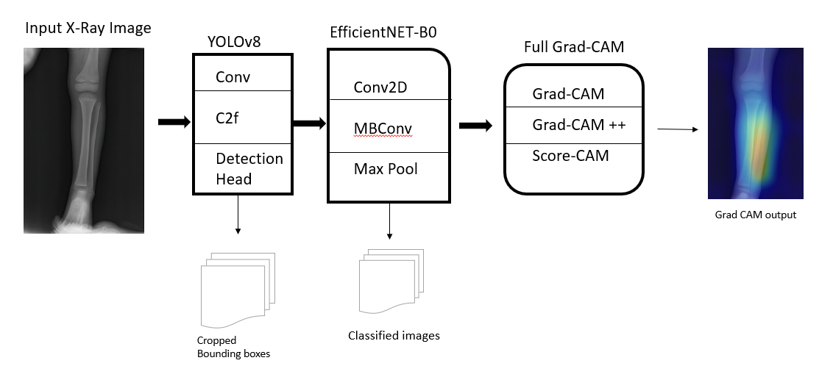
Hybrid Model architecture

Slide 70
Input X-Ray Image: A grayscale X-ray of a bone is fed into the system for fracture analysis.
YOLOv8 Detection: YOLOv8 detects regions of interest (e.g., potential fractures) and outputs cropped bounding boxes for further inspection.
EfficientNet-B0 Classification: The cropped images are passed to EfficientNet-B0, which classifies them (e.g., fracture or no fracture) using Conv2D, MBConv, and Max Pool layers.
Explainability via Full Grad-CAM: Grad-CAM, Grad-CAM++, and Score-CAM are applied to visualize which parts of the image influenced the model’s decision.
Heatmap Generation: The output is a Grad-CAM heatmap showing the important areas contributing to the classification.
Clinical Interpretability: This combined approach enhances automated diagnosis with visual explanations, making the model's decisions interpretable for clinicians.

Slide 71
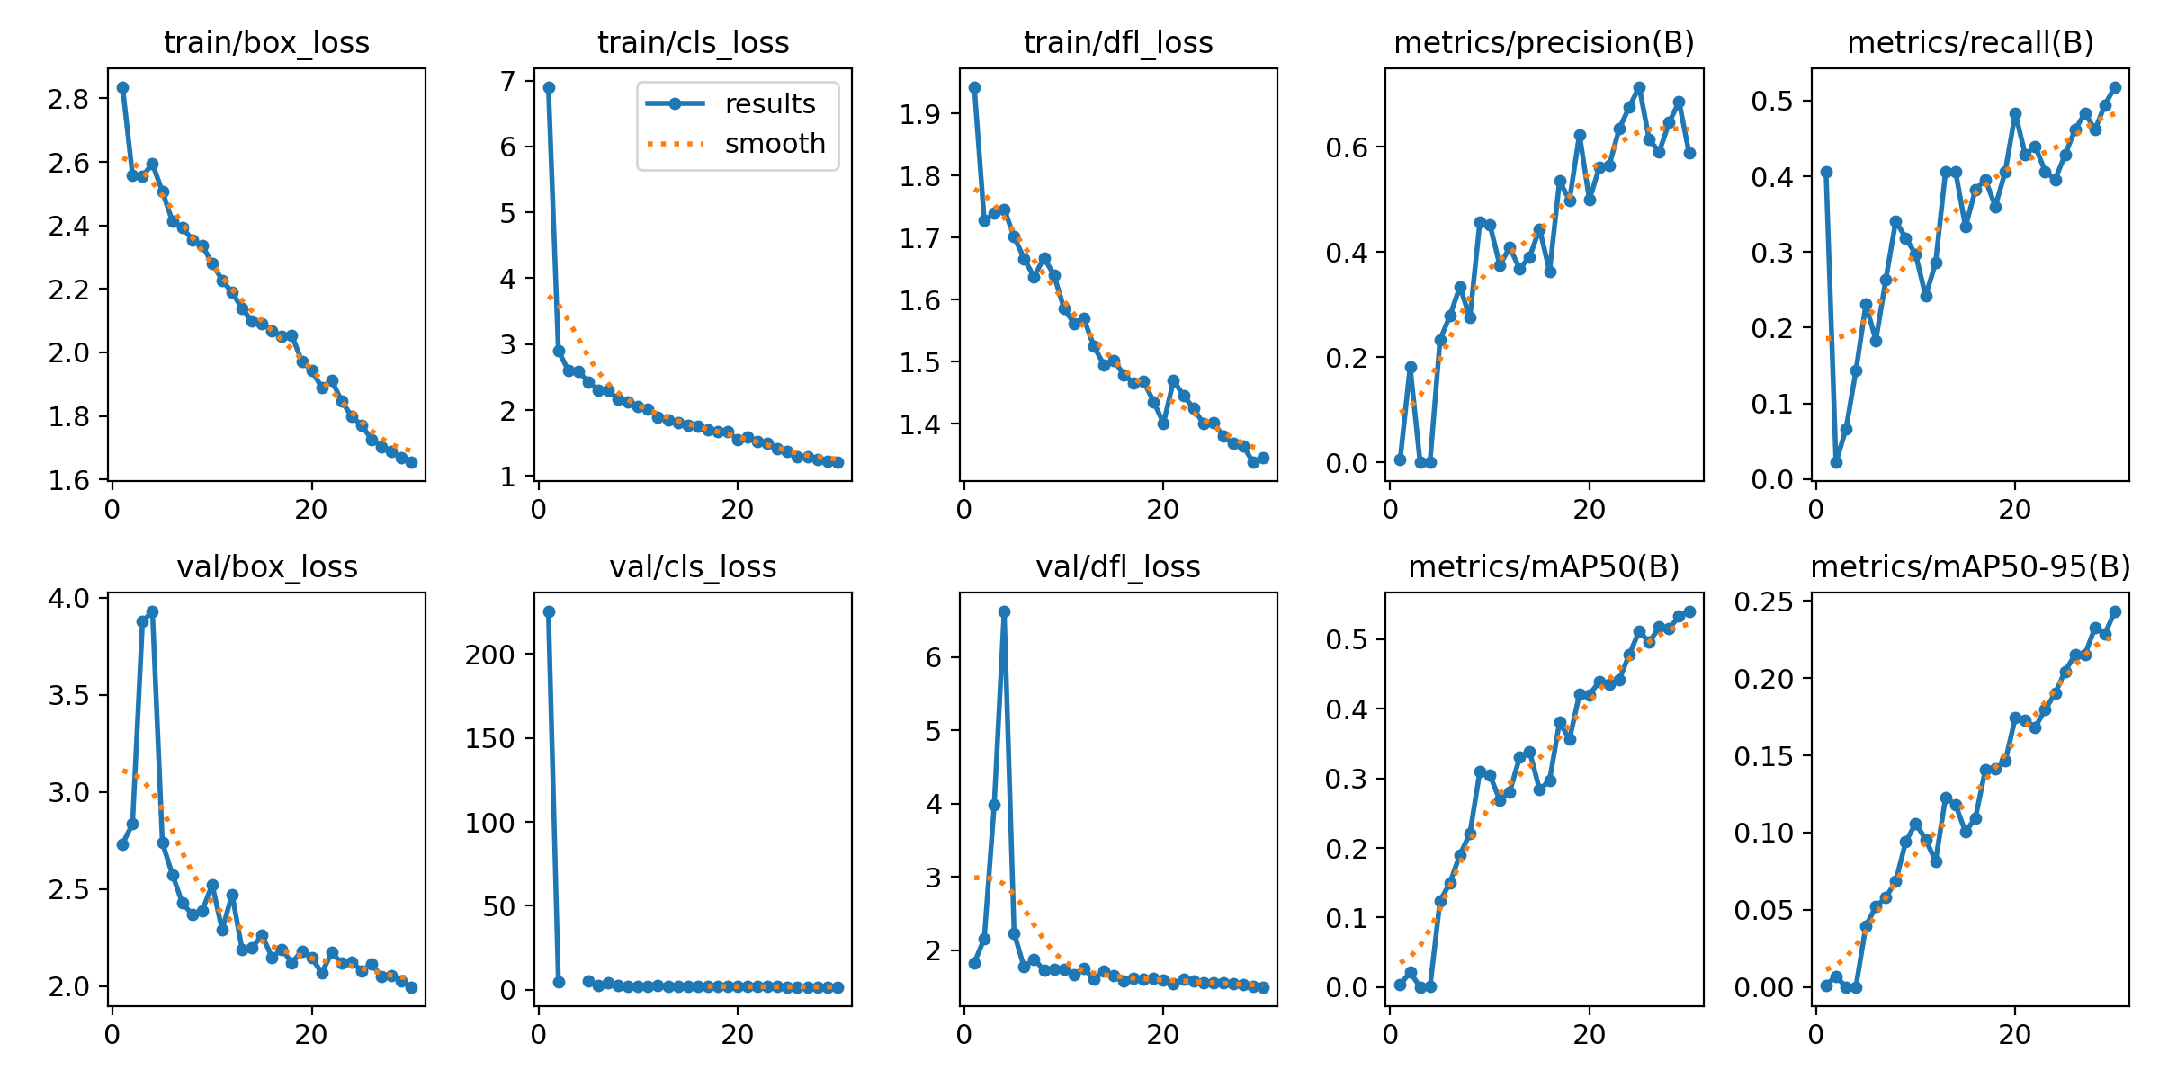
Results
This plot shows the evolution of training and validation losses and evaluation metrics over 30 epochs for the YOLOv8 + EfficientNet-B0 model. The training losses (box_loss, cls_loss, dfl_loss) all show a clear downward trend, indicating that the model is learning effectively. Validation losses also decrease, especially box_loss and dfl_loss, though cls_loss starts high and quickly stabilizes. Metrics like precision, recall, and mean Average Precision (mAP50, mAP50-95) improve steadily across epochs, demonstrating enhanced object detection and classification performance as training progresses.

Slide 72
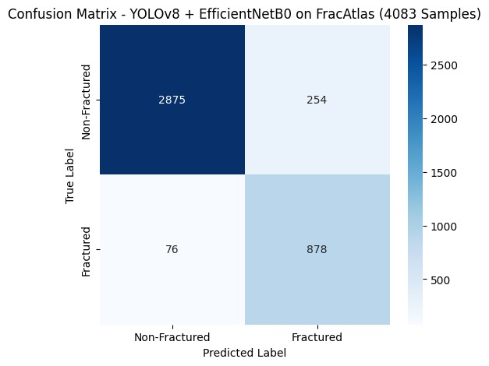
Confusion Matrix
The confusion matrix represents the classification performance on 4,083 samples from the FracAtlas dataset. Out of all true non-fractured cases, 2,875 were correctly predicted, and 254 were misclassified as fractured. For fractured cases, 878 were correctly identified, and only 76 were wrongly classified as non-fractured. This matrix reveals a high true positive and true negative rate, confirming that the model is effective in distinguishing between fractured and non-fractured images.

Slide 73

Evaluation Metrics Bar Chart
This bar chart summarizes the model’s performance using several evaluation metrics. The accuracy is 91.68%, meaning the model predicts correctly most of the time. Precision is 77.56%, reflecting the proportion of predicted fractured cases that are truly fractured. The recall is high at 92.03%, indicating the model effectively finds most actual fractures. The F1-score, a harmonic mean of precision and recall, stands at 84.06%. The specificity is 91.88%, showing the model’s ability to correctly identify non-fractured cases. The AUROC (Area Under ROC Curve) is 94%, suggesting excellent discrimination ability between the classes.

Slide 74

Predictions Outcomes Pie Chart
This pie chart illustrates the distribution of prediction outcomes over 4,083 test samples. The majority (70.4%) are True Negatives (correctly identified non-fractures), followed by True Positives (21.5%), showing accurate fracture identification. Only 6.2% are False Positives (non-fractures misclassified as fractures), and a small 1.9% are False Negatives (fractures missed by the model). The overall balance in prediction outcomes supports the model’s strong reliability in medical decision support.

Slide 75

ROC Curve
The ROC (Receiver Operating Characteristic) curve evaluates the model's classification performance. The orange curve represents the true performance, and the dashed diagonal line shows random guessing (AUC = 0.5). The model achieves an AUC of 0.96, which is very close to perfect classification. This demonstrates that the model has a very low false positive rate while maintaining a high true positive rate, making it highly suitable for clinical applications in fracture detection.

Slide 76

outputs
The two X-ray images on the left display fracture detection results using YOLOv8. The bounding boxes are drawn around the detected fracture areas:
In the top-left, the label “fractured 0.77” indicates a fracture detected with 77% confidence.
In the middle-left image, two fractures are detected with confidence scores of 0.45 and 0.78 respectively, highlighting multi-fracture detection capability.
These bounding boxes define the Region of Interest (ROI) for further processing.

Slide 77

Below the detection results, one of the ROIs is cropped and resized for classification. This focuses the classification model (EfficientNet-B0) on just the relevant fractured region, improving accuracy and reducing noise from unrelated parts of the X-ray.

Slide 78

The two X-ray images on the right show the final classification of the detected fractures:
The bounding boxes now label the type of fracture, such as "Comminuted" (a type of severe fracture where bone is broken into multiple pieces).
This illustrates that the EfficientNet-B0 model is not only detecting fractures but also categorizing them by type.

Slide 79

The last two images show the Grad-CAM++ heatmaps for explainability:
Red to yellow areas indicate high attention regions where the model focused to make its decision.
This helps radiologists or clinicians visually verify that the model is indeed identifying the correct area (fracture zone) while predicting the outcome.

Slide 80
Existing Models vs. Proposed Hybrid Model
Aspect | Existing Models | Proposed Hybrid Model
Task Design | Single-task: either detection or classification | Multi-task: detection (YOLOv8) + classification (EfficientNet) + explainability (Grad-CAM++)
Detection & Classification | Basic or no detection; poor small fracture classification | Detects multiple precise ROIs and classifies them individually for better accuracy
Explainability | Minimal or unclear saliency maps | Grad-CAM++ provides clear, class-specific attention maps over fracture regions
Modularity & Adaptability | Monolithic; needs full retraining for changes | Modular; only classifier needs retraining when new data or types are introduced
Medical Image Performance | May generalize poorly; trained on generic datasets | Uses transfer learning and fine-tuning on medical X-rays for high accuracy
Efficiency & Multi-Fracture Handling | Slower inference; limited to single fracture detection | Fast ROI extraction via YOLOv8 and efficient classification of multiple fractures

Slide 81
conclusion
The proposed hybrid model, integrating YOLOv8 for precise fracture detection, EfficientNet-B0 for accurate fracture type classification, and Grad-CAM++ for visual explainability, provides a robust and intelligent solution for automated fracture analysis in medical X-rays. Unlike traditional single-task CNN models, this multi-task pipeline effectively handles multiple fractures, improves classification accuracy through region-based analysis, and offers clear, interpretable visualizations of decision-making regions. Its modular architecture allows easy adaptability to new data with minimal retraining, while transfer learning ensures strong generalization to medical imaging. With high accuracy, recall, specificity, and AUROC, combined with real-time inference speed and clinical interpretability, this model presents a scalable, reliable, and transparent tool for enhancing diagnostic workflows in radiology.

Slide 82
Future Work
Fracture Severity Classification: Extend the model to classify not just fracture presence but also the severity (e.g., mild, moderate, severe) for more actionable insights.
Region-Specific Diagnosis: Train the model to detect and classify fractures in specific bone regions (e.g., humerus, radius, femur) to support targeted treatment.
Incorporate Clinical Metadata: Combine patient metadata (e.g., age, gender, medical history) with image data using multi-modal deep learning for improved diagnostic accuracy.
Temporal Fracture Analysis: Use sequential models like 3D CNNs or Spatio-Temporal Transformers to analyze fracture progression over time.
Edge Deployment: Optimize the model for mobile or embedded systems using quantization and pruning to enable real-time fracture detection in remote clinics.
Explainability & Trust: Integrate explainable AI techniques (e.g., Grad-CAM, SHAP) to help radiologists understand the model’s decision process.
Larger Clinical Trials: Validate the model across multiple hospitals and diverse populations to ensure generalizability and clinical adoption.

Slide 83

Case study

Slide 84
MURA: Large Dataset for Abnormality Detection in Musculoskeletal Radiographs
Dataset Composition: MURA is a large musculoskeletal radiograph dataset containing 40,561 images from 14,863 studies, each labeled by radiologists as normal or abnormal.
Test Set and Evaluation: The test set comprises 207 studies, with labels collected from six board-certified Stanford radiologists. The majority vote of three radiologists serves as the gold standard for evaluation.
Model Architecture and Performance: A 169-layer DenseNet model is trained as a baseline, achieving an AUROC of 0.929, with 0.815 sensitivity and 0.887 specificity.
Radiologist Comparison: Model performance, evaluated using Cohen’s kappa, is comparable to top radiologists for finger and wrist studies, but inferior on elbow, forearm, hand, humerus, and shoulder studies.
Research Contribution: The dataset is freely available to encourage further research in abnormality detection in musculoskeletal radiographs.

Slide 85

Model
Input - Radiographic Study with Multiple Views: Each study (e.g., an elbow study) may contain one or more X-ray images called views (like View 1, View 2, etc.). These views are input separately to the model.
169-layer Convolutional Neural Network (CNN): Each view is passed individually through a 169-layer DenseNet CNN. The network predicts the probability of abnormality for each image view.
Arithmetic Mean of Probabilities: The model averages the abnormality probabilities predicted for all views in a study. This mean value represents the final abnormality score for the entire study.
Output - Probability of Abnormality: The final output is a single probability score indicating how likely the full study (across all views) is abnormal.

Slide 86


Results
Multi-view Analysis: The model takes multiple X-ray views (e.g., elbow, hand) from a single study to predict the probability of abnormality more accurately.
Abnormality Localization: The heatmap highlights regions (e.g., wrist) where the model focuses its attention, helping identify potential abnormalities like fractures.
Interpretability for Clinicians: Visualization through Grad-CAM helps radiologists understand the model's decision-making by showing which areas influenced the prediction.

Slide 87
A novel approach towards the classification of Bone Fracture from Musculoskeletal Radiography images using Attention Based Transfer Learning
CAD’s growing role in medical imaging: Recent advances in computer vision and deep learning have made computer-aided diagnosis indispensable for tasks such as classification, segmentation, and localisation in biological images, especially X-ray analysis for bone fractures.
Focus on FracAtlas dataset: The study uses the FracAtlas collection of 4,083 musculoskeletal radiographs as the benchmark for fracture classification experiments.
Attention-based transfer learning: An attention module is added on top of standard transfer-learning backbones (e.g., InceptionV3, DenseNet121) to let the network concentrate on fracture-relevant regions in each X-ray.
Rigorous optimisation pipeline: Careful hyperparameter tuning and training strategies raise the model’s performance to state-of-the-art levels (> 90 % accuracy) on the fracture vs. non-fracture classification task.
Implications and future work: Results underscore the effectiveness of combining transfer learning with attention for medical-image tasks and point toward further exploration of such hybrid approaches in X-ray processing and other imaging modalities.

Slide 88

Model
InceptionV3 Architecture

Slide 89
1. Input and Initial Convolution Layers:
The model starts with an input image (likely an X-ray).
A series of Convolution Layers (orange) and Max Pooling Layers (blue) are used to extract basic image features like edges and textures.
These layers help reduce dimensionality and prepare the image for deeper analysis.
2. Inception Modules (Mixed0 to Mixed10):
The architecture contains Inception blocks (Mixed0 to Mixed10), each combining parallel convolution paths (of different kernel sizes) to capture features at multiple scales.
After convolution, the outputs are concatenated (pink) along the channel dimension.
Pooling operations (green for average pooling, blue for max pooling) further refine the feature maps inside some modules.

Slide 90
3. Feature Refinement with Pooling and Activation:
After each block, activation layers (teal) introduce non-linearity, enabling the model to learn complex patterns.
Average and Max Pooling help reduce spatial dimensions while preserving important features.
The stacking of these modules increases the receptive field and abstraction level.
4. Attention Mechanism (BAM):
The Bottleneck Attention Module (BAM), although not shown in a specific block, is referenced in the legend (purple).
BAM likely helps the network focus on fracture-relevant regions by re-weighting feature maps based on spatial and channel-wise attention.
5. Classification Block and Output:
Final layers include Global Average Pooling (red) and activation functions, followed by a classification block.
This block combines all the learned features and outputs the final classification — e.g., fractured vs non-fractured, or fracture type categories.

Slide 91

Results

Slide 92
The app provides a simple GUI with options to open, predict, save, clear, and quit.
It uses YOLOv8 to detect fractures, metal implants, and text in wrist X-rays.
Each detection is labeled with the class name and confidence score (e.g., fracture 0.71).
The model shows high accuracy with clear bounding boxes around detected regions.
It supports both left and right wrist X-ray images in different orientations.
Predictions are displayed instantly on the image with an option to save the results.

Slide 93
Detection of bone fracture based on machine learning techniques
Computers enhance various sectors including banking, education, communication, and medicine.
Traditional X-ray scanners often produce unclear images, risking misdiagnosis of bone fractures.
The system uses pre-processing, edge detection, feature extraction, and machine learning for accurate diagnosis.
Machine learning is applied in many fields, with this system focused on bone fracture detection using 270 X-ray images.
Among several algorithms tested, SVM achieved the highest accuracy (0.92), outperforming other models like Naïve Bayes and Random Forest.

Slide 94

Model
Input: Start with an X-ray image.
Pre-processing: Remove noise and enhance contrast in the image.
Edge Detection: Apply the Canny edge detection algorithm.
Feature Extraction: Use GLCM (Gray Level Co-occurrence Matrix) to extract texture features.
Classification: Classify the features using ML models like SVM, Decision Tree, Naive Bayes, Random Forest, or Nearest Neighbor.

Slide 95
Results
ML Algorithm | Precision | Recall | Accuracy
Naïve Bayes | 0.882353 | 0.652174 | 0.642857
Decision Tree | 0.906977 | 0.847826 | 0.803571
Nearest Neighbors | 0.836364 | 1 | 0.839286
Random Forest | 0.88 | 0.956522 | 0.857143
SVM | 0.9375 | 0.978261 | 0.928571
This study used machine learning algorithms to detect bone fractures from X-ray images. Among the models tested—Naïve Bayes, Decision Tree, Nearest Neighbors, Random Forest, and SVM—SVM performed the best with 92.86% accuracy, 93.75% precision, and 97.83% recall. Random Forest and Nearest Neighbors also showed good results, while Naïve Bayes had the lowest accuracy at 64.29%. Overall, SVM proved to be the most effective algorithm for accurate bone fracture detection.
Applied Machine learning Algorithms.

Slide 96
Bone Fracture Detection Using Deep Supervised Learning from Radiological Images: A Paradigm Shift
Bone diseases, especially musculoskeletal conditions (MC), affect around 1.71 billion people worldwide.
Common bone issues include fractures, femoral neck injuries, and knee osteoarthritis.
The rate of such conditions is expected to double in the next 30 years.
Missed fractures are a frequent diagnostic error in emergency settings, leading to delayed treatment.
Artificial Intelligence (AI), particularly Deep Learning (DL), is gaining attention in fracture detection.
DL is widely used in medical image analysis to assist radiologists.
Studies in traumatology and orthopaedics show DL’s potential for detecting bone abnormalities.
A systematic review explores the use, challenges, and future of DL in bone imaging.

Slide 97

Model

Slide 98
Image Acquisition: Medical images are collected using MRI, X-ray, CT scan, or ultrasound.
Pre-processing: Raw images are processed to improve quality and remove noise.
Enhanced Image: Clear, high-quality images are produced for better analysis.
Deep Learning Algorithm (DCN): Images are fed into a deep convolutional neural network.
Detection: The algorithm localizes the general area of the fracture.
Characterization:
Extracts discriminative features from the fracture region.
Diagnoses the type of fracture.
Performance Evaluation: Model is tested on external datasets to assess sensitivity and accuracy.
Clinical Practice Detection: The validated model is used in real-world clinical settings to assist doctors in fracture diagnosis.

Slide 99

Results
The image shows sample wrist X-rays used for fracture detection. Subfigure (a) includes two X-rays labeled as fractured, showing visible breaks in the bone, while subfigure (b) shows non-fractured wrists with normal bone structure. These examples illustrate the visual differences between fractured and healthy cases and are likely used in the study to train and evaluate a deep learning model for automatic fracture classification.

Slide 100
references
[1] P. Rajpurkar, J. Irvin, A. Bagul, D. Ding, T. Duan, H. Mehta, B. Yang, K. Zhu, D. Laird, R. Ball, C. Langlotz, K. Shpanskaya, M. P. Lungren, and A. Y. Ng, “MURA: Large Dataset for Abnormality Detection in Musculoskeletal Radiographs,” arXiv:1712.06957, Dec. 2017.
[2] S. S. F. Ruhi, F. Nahar, and A. F. Ashrafi, “A novel approach towards the classification of bone fracture from musculoskeletal radiography images using attention based transfer learning,” arXiv:2410.14833, Oct. 2024.
[3] D. Ahmed and R. Hawezi, “Detection of bone fracture based on machine learning techniques,” *Measurement: Sensors*, vol. 27, p. 100723, Jun. 2023, doi:10.1016/j.measen.2023.100723.
[4] T. Meena and S. Roy, “Bone fracture detection using deep supervised learning from radiological images: A paradigm shift,” *Diagnostics*, vol. 12, no. 10, p. 2420, Oct. 2022, doi:10.3390/diagnostics12102420.

Slide 101


